Slide 1
LOGICAL DIAGNOSIS
OF
CAVITY DEFECTS IN IRON CASTINGS

Slide 2
Cavity Defects May Appear as:
- spherical
- rounded
- irregular

Slide 3
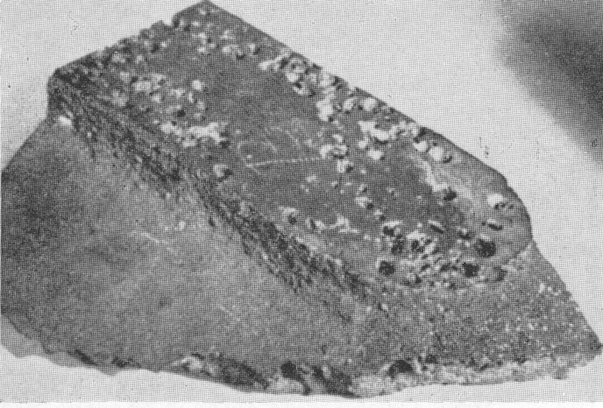
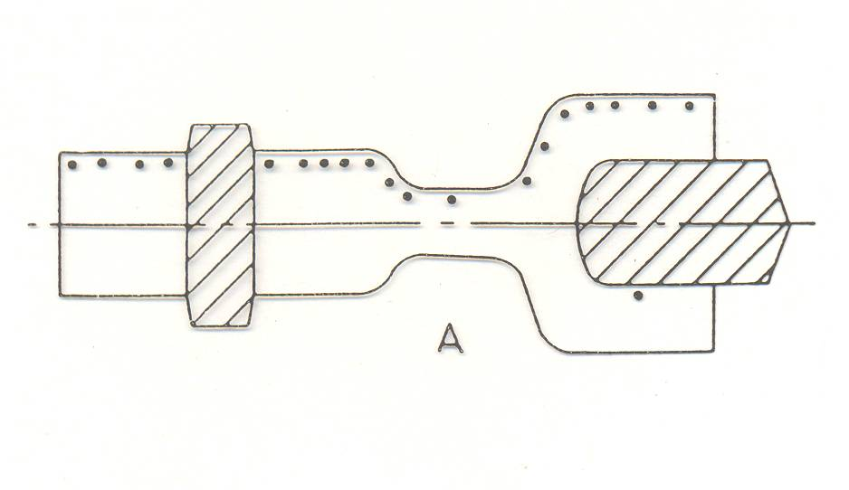
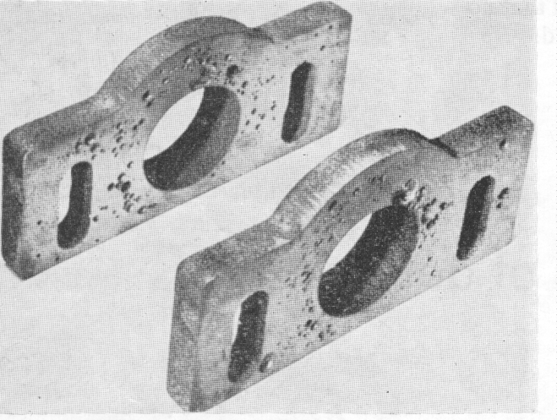
SPHERICAL HOLES
CO-gas Defects
More severe type of the gas hole defects shown in previous figure with inclusion of slag particles.
Form: on the top surface, revealed during machining – sometimes discovered underneath a core.
Causes:
Low pouring temperature
High Mn and S contents
Dirty ladles, lacks of skimming, poor refractory quality
Gas holes on top surface only, revealed by machining.

Slide 4
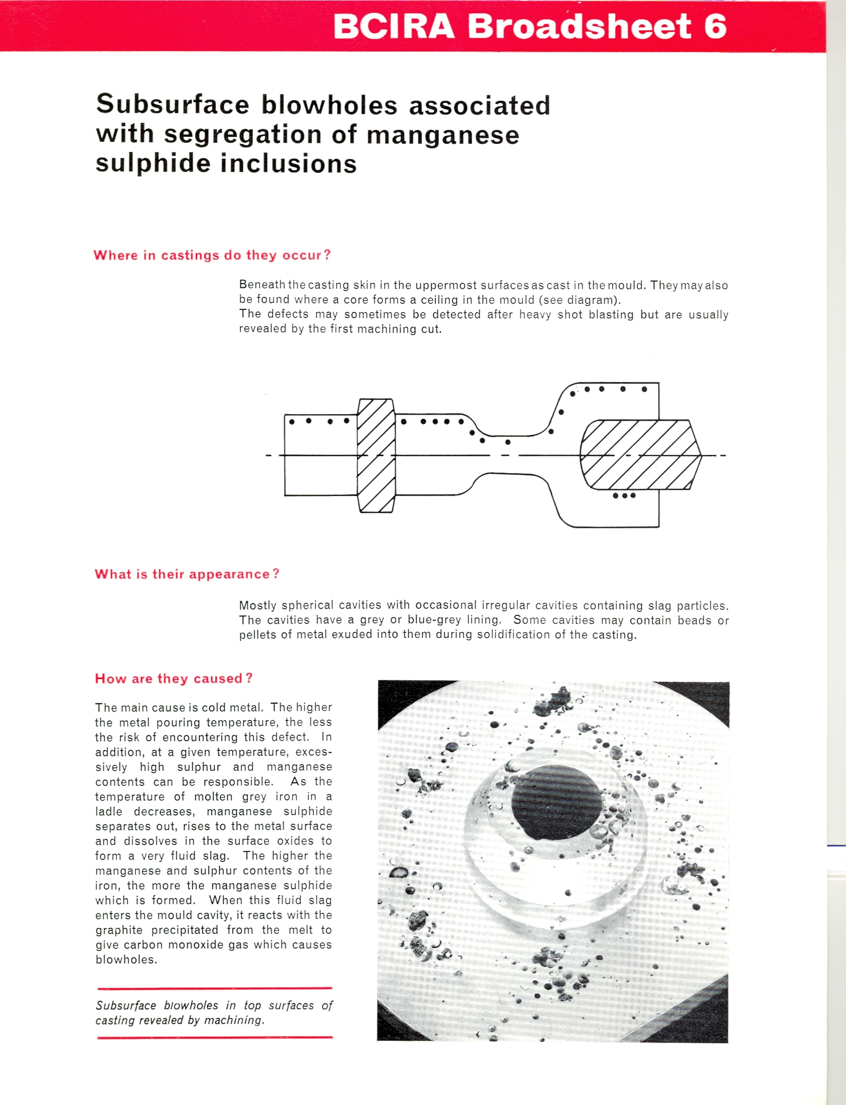

Slide 5
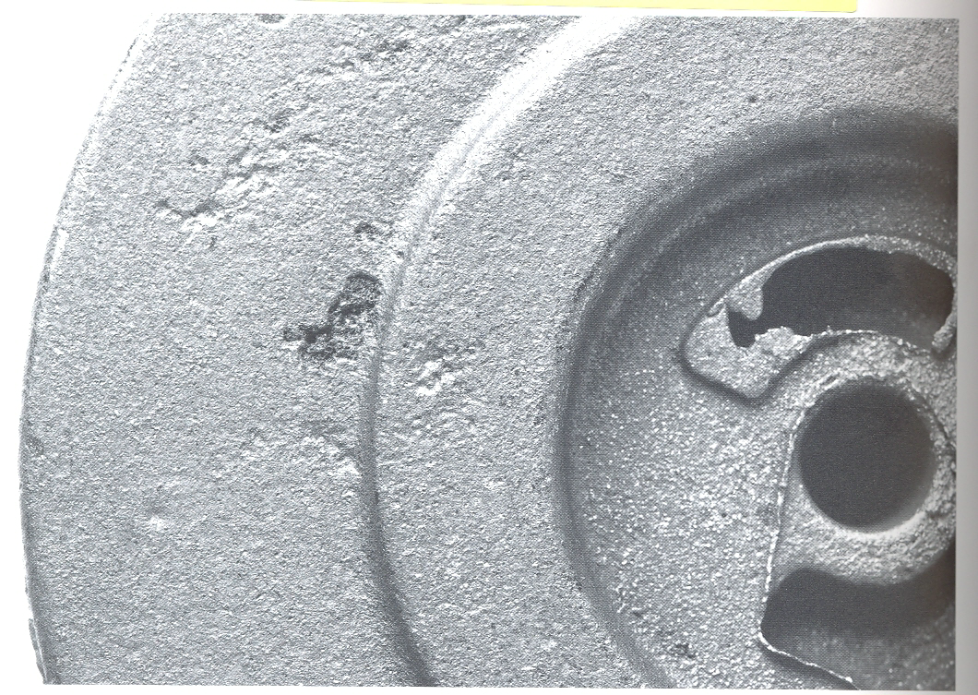
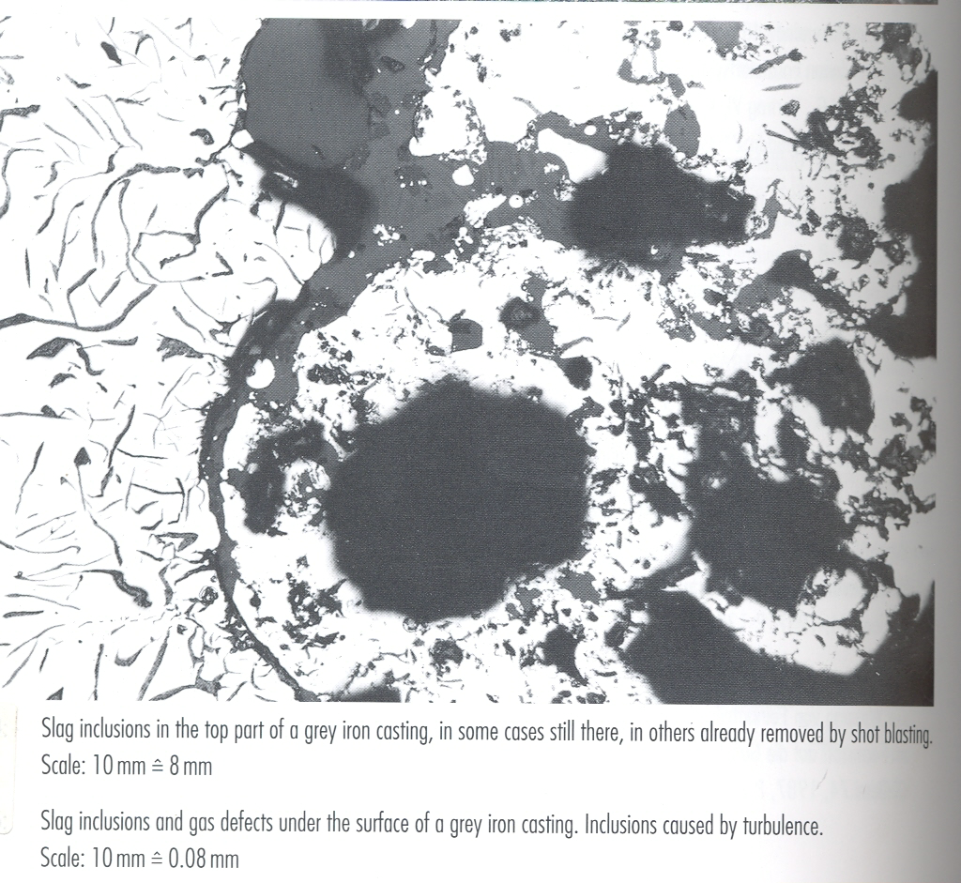

Slide 6
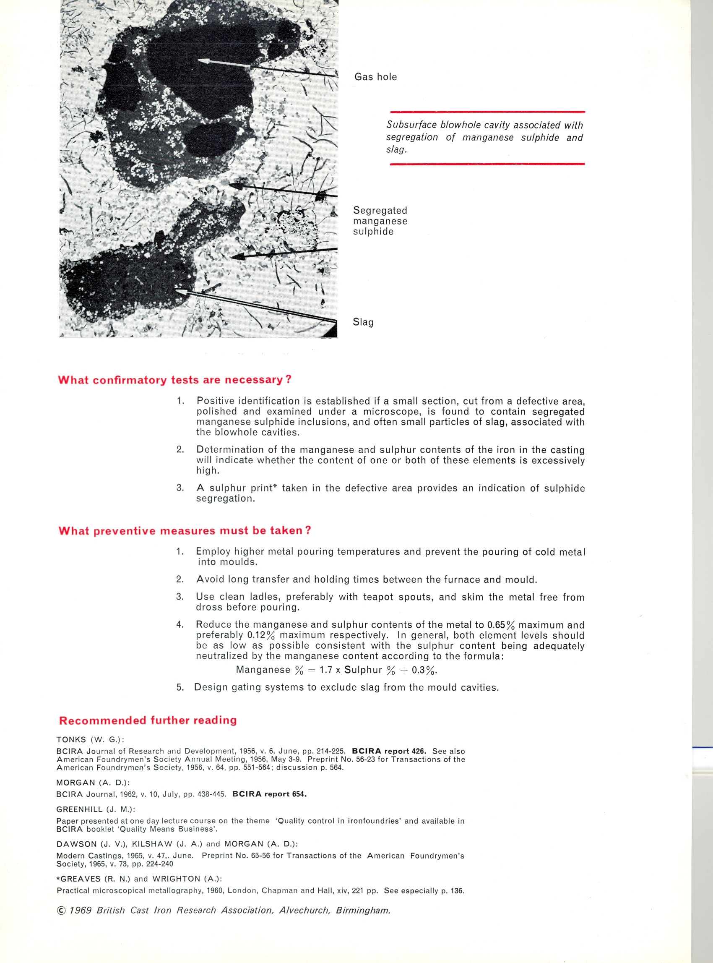
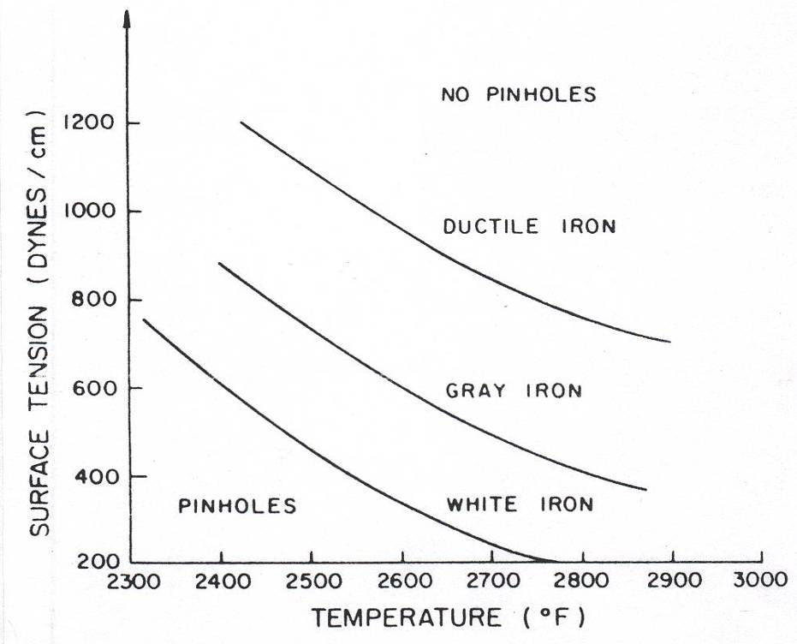
Effect of Sulfur and Manganese Content on Occurrence of Subsurface Gas Holes in Gray Iron Castings.

Slide 7
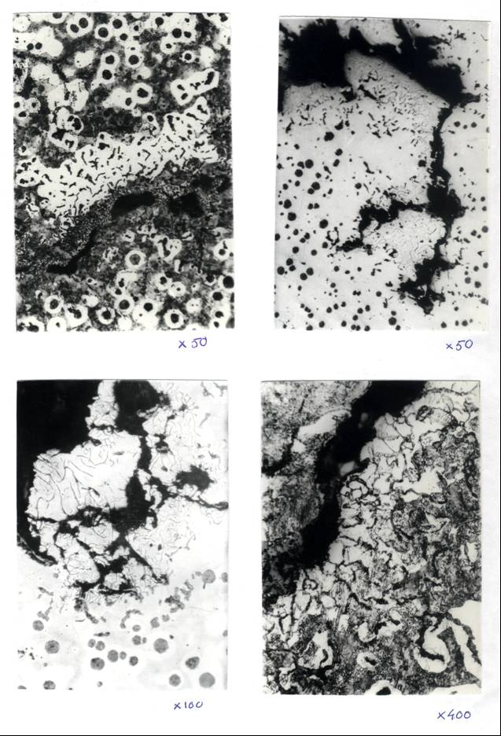

Slide 9
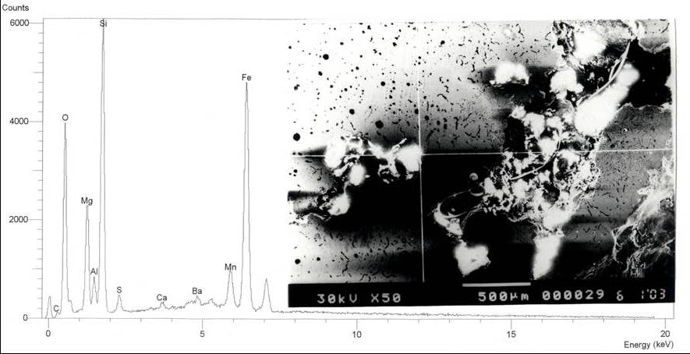

Slide 10
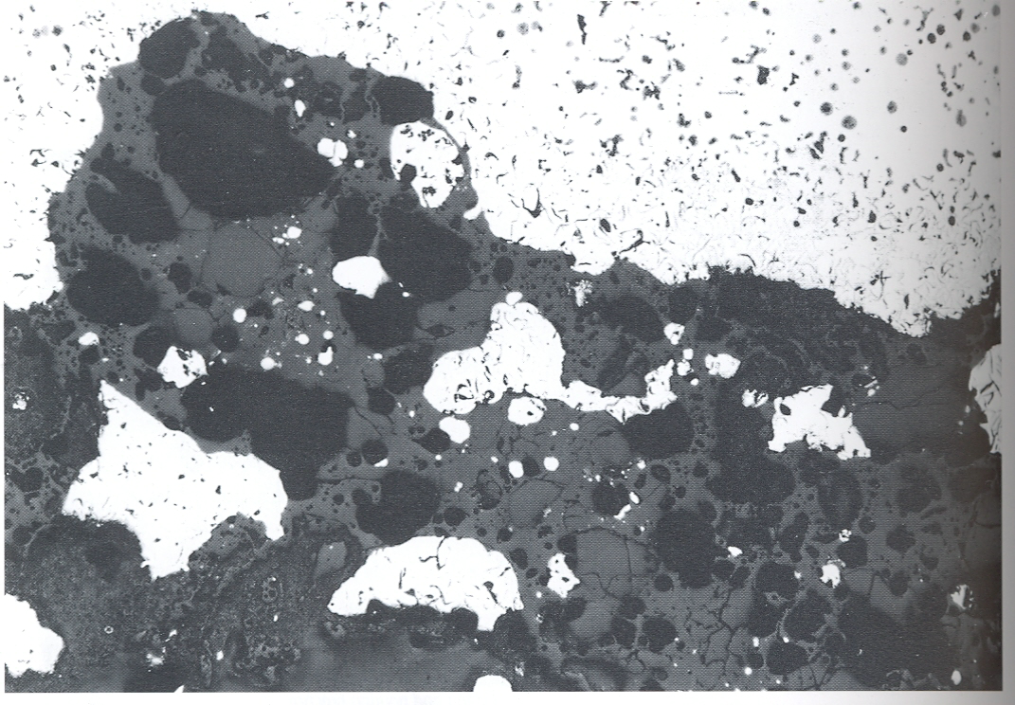
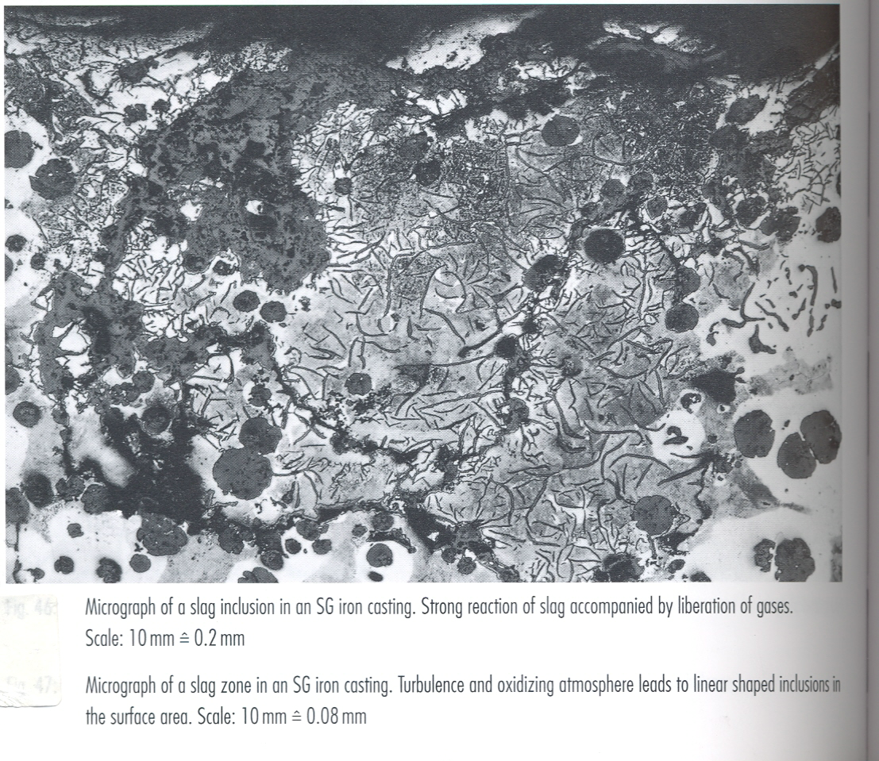
Micrograph of a slag zone in an SG iron casting. Turbulence and oxidizing atmosphere leads to linear shaped inclusions in the surface area.
Micrograph of a slag inclusion in an SG iron casting. Strong reaction of slag accompanied by liberation of gases.

Slide 11
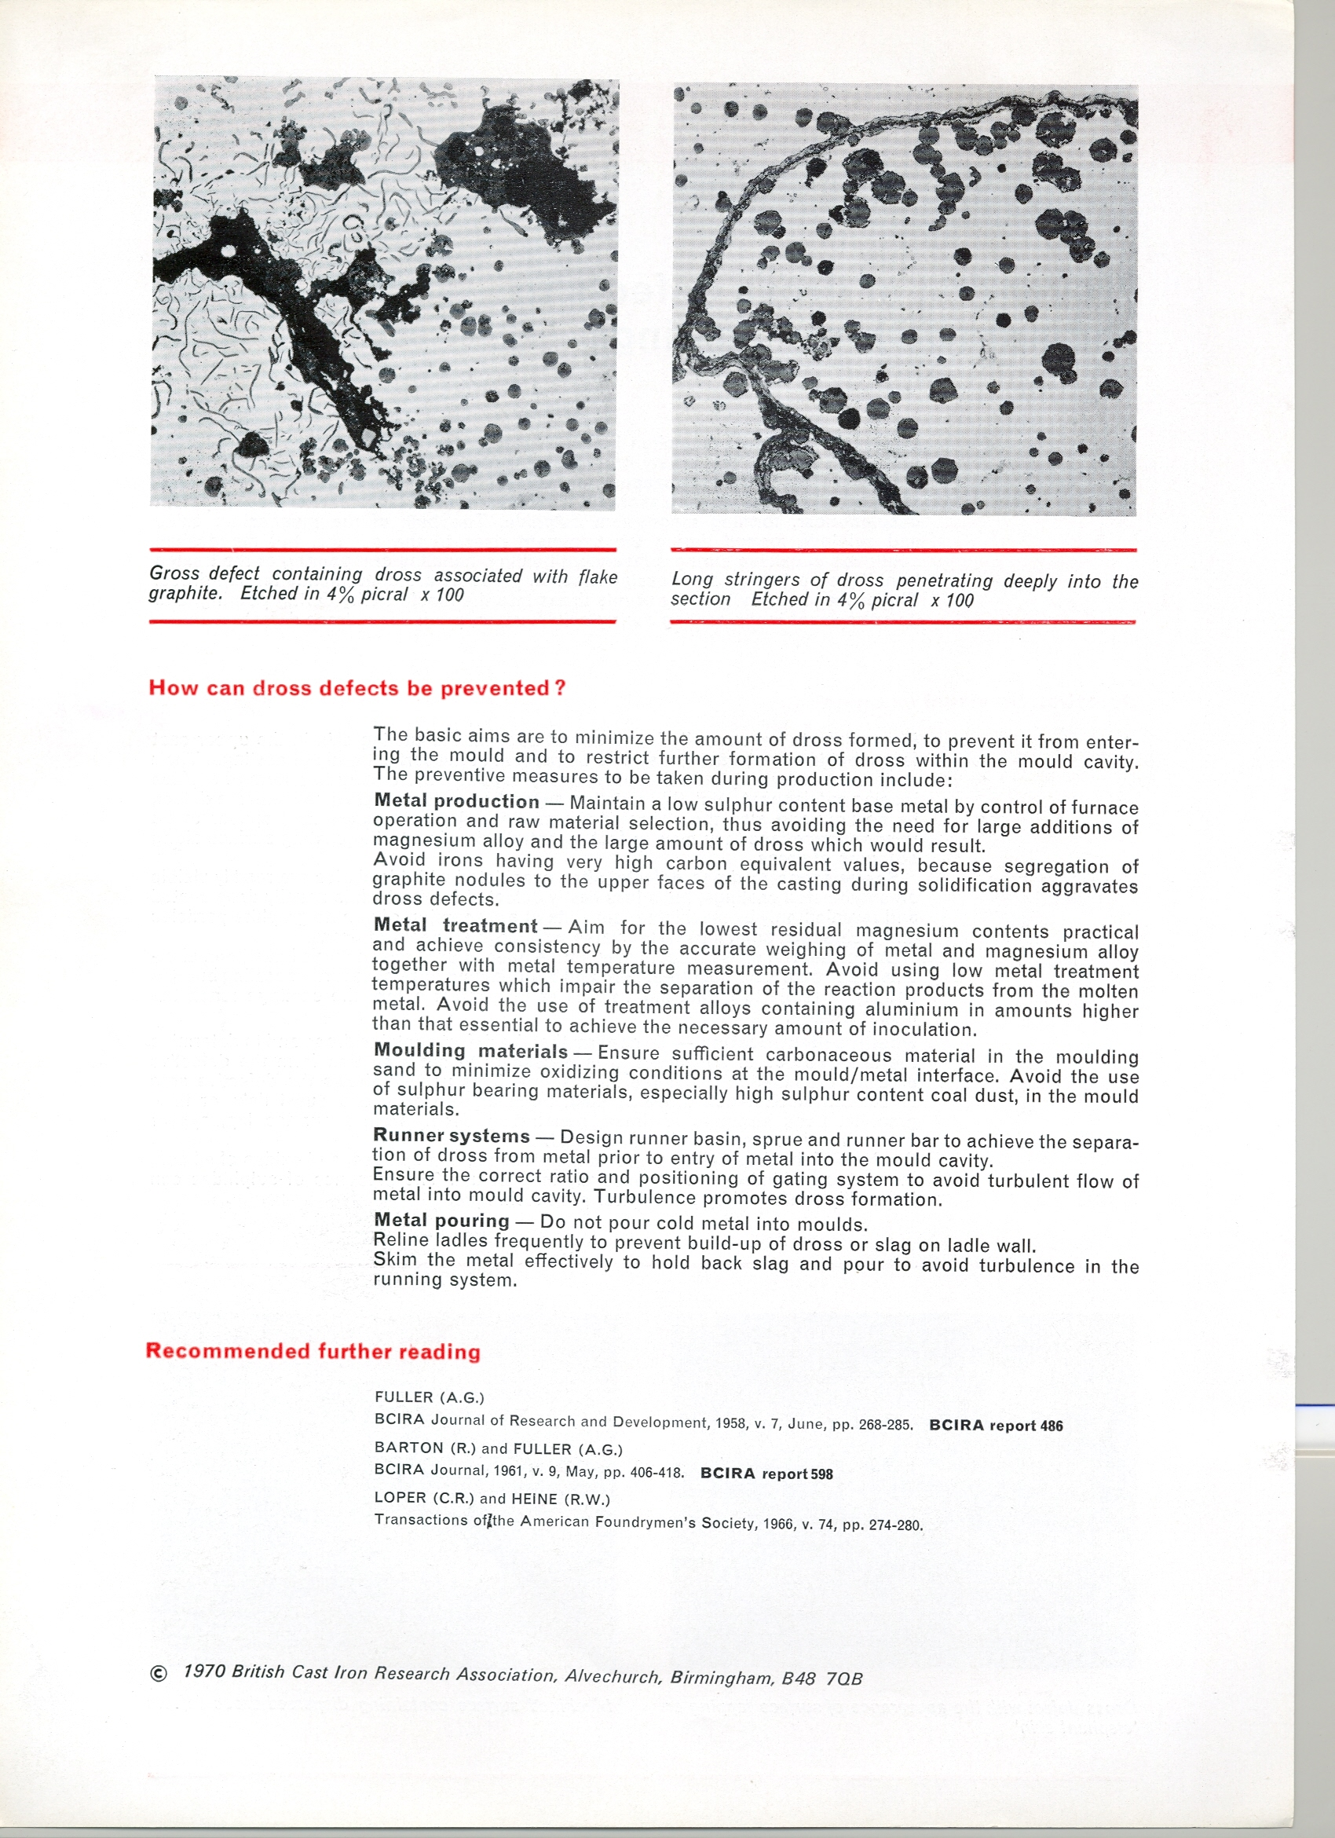
Gross defect containing dross associated with flake graphite. Etched in 4% picral.
Long stringers of dross penetrating deeply into the section Etched in 4% picral.

Slide 12
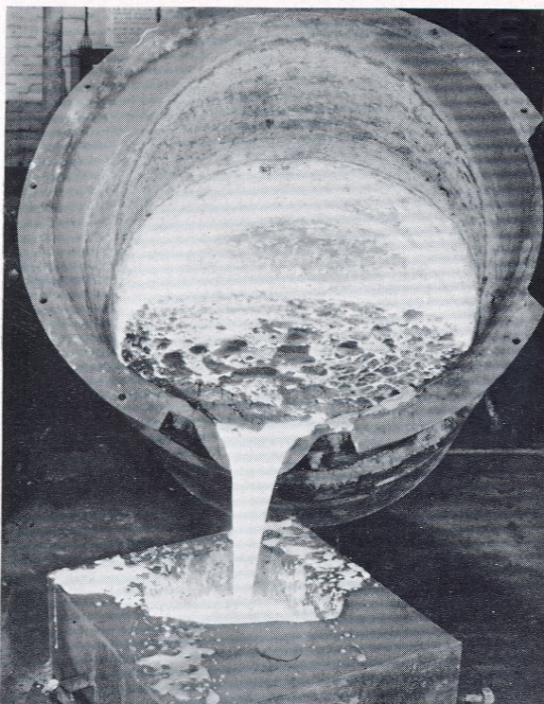
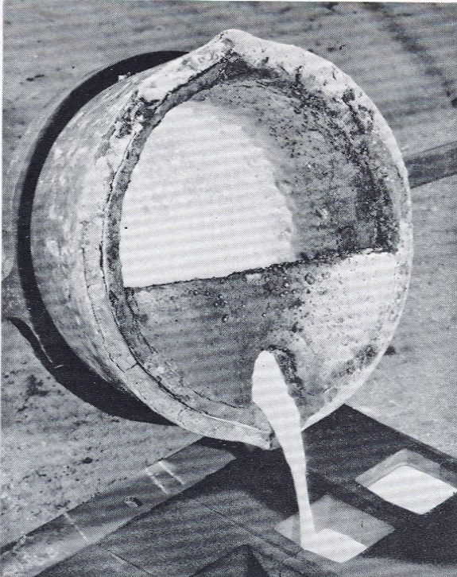

Slide 13
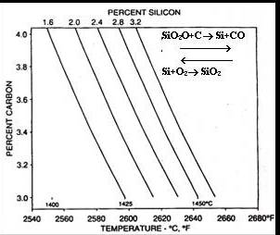
REACTIVE SLAG FORMATION
Reactive slag is a reoxidation product that form when molten cast iron is cooled from melting process temperature.
Main constituents are:
SiO₂, MnO and FeO
Gray iron low in Mg and Al
Typical slag formation temperature on cooling is 1400°C (depending on Si-contents).
Temperatures in the figure refer to the beginning of selective Si oxidation on cooling which initiates siliceous slag formation.
Above this temperature, C is preferentially oxidized rather than Si.
The oxidation of Si to a slag particle is associated with entry into the SiO₂-FeO system, in which FeO becomes a dominant part of the slag composition as temperature decreases.
Fayalite, Fe₂SiO₄ is an increasing portion of the siliceous slag as FeO increases in cast iron.
Equilibrium Temperature of Silica Reduction or Silicon Reoxidation as Related to %C and %Si. Reoxidation of Silicon and Initial Silicate Slag Formation can Begin on Cooling Below the Indicated Temperature When Oxygen is Present

Slide 14
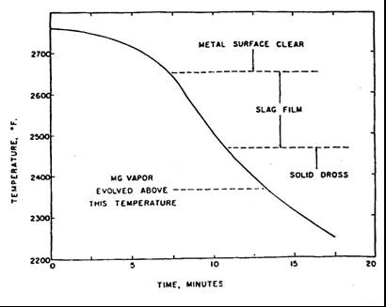
REACTIVE SLAG FORMATION (Cont’d.)
If reoxidation continues on a falling temperature, the FeO-content of slag could reach 60-90%.
Because iron is over 95% of the cast iron composition, Fe oxidizes more readily as temperature decreases, there is a continuing increase in % FeO in the slag during the temperature regime from pouring to solidification.
The FeO in the slag provides the pinhole reaction:
FeO + C → Fe + CO (g)

Slide 15
SLAG ANALYSIS
The range of oxide percentages in slag can be expected over the range of temperature from initial film formation downward (from 1470°C to below 1280°C).
Over this range, MgO, Al₂O₃, SiO₂, MnO and FeO would be the order of reoxidation during cooling, based on thermodynamic considerations alone.
The formation of FeO would increase throughout the decreasing temperature range because Fe is the principal element present, is oxidizable throughout the temperature range, and more reactive as temperature decreases.
The highest FeO slag, ~90% FeO, appears in the slag stringers.

Slide 16
MECHANISM OF SLAG BLOWHOLE FORMATION
The entrapment of slag in the molten iron during pouring is a key factor in the formation of blowholes in ductile iron castings.
The reactions that are operative in the generation of blowhole porosity:
SiO₂ + 2 C Si + 2 CO
MnO + C Mn + CO
FeO + C Fe + CO
Kinetics of the reaction appear to be controlled by the physical nature of the slag
Both temperature and composition are important in achieving a fluid slag, which can wet the graphite that forms on solidification.
Slag fluidity increases with the increase of MnS in its composition:
  FeS + Mn MnS + Fe
  Lower Temp.

Slide 17
SLAG DEFECTS IN DUCTILE IRON
Magnesium and other deoxidizers can alter the course of slag formation.
With Mg in ductile iron, the slag initiation temperature may be raised.
The principle effect of Mg is to raise the temperature at which reoxidation begins the slag formation process on melt surface.
Slag composition moves in the same direction as on gray irons, as the Mg is gradually oxidized from the melt.
Formation of this slag in furnace and ladles, in gating systems and mold cavities leads to its appearance on casting surfaces.
Reaction blowholes accompany this process and casting dross defects become evident.

Slide 18
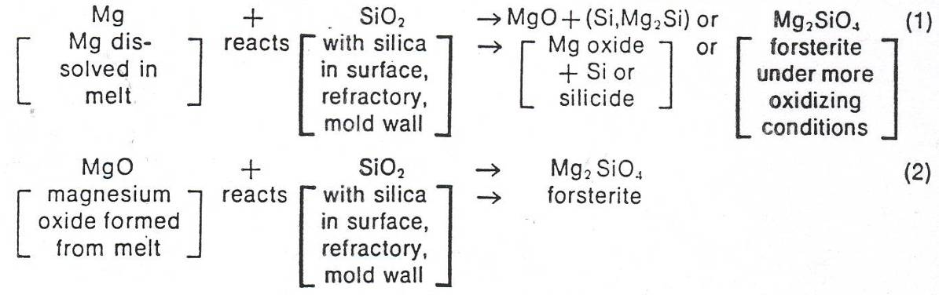
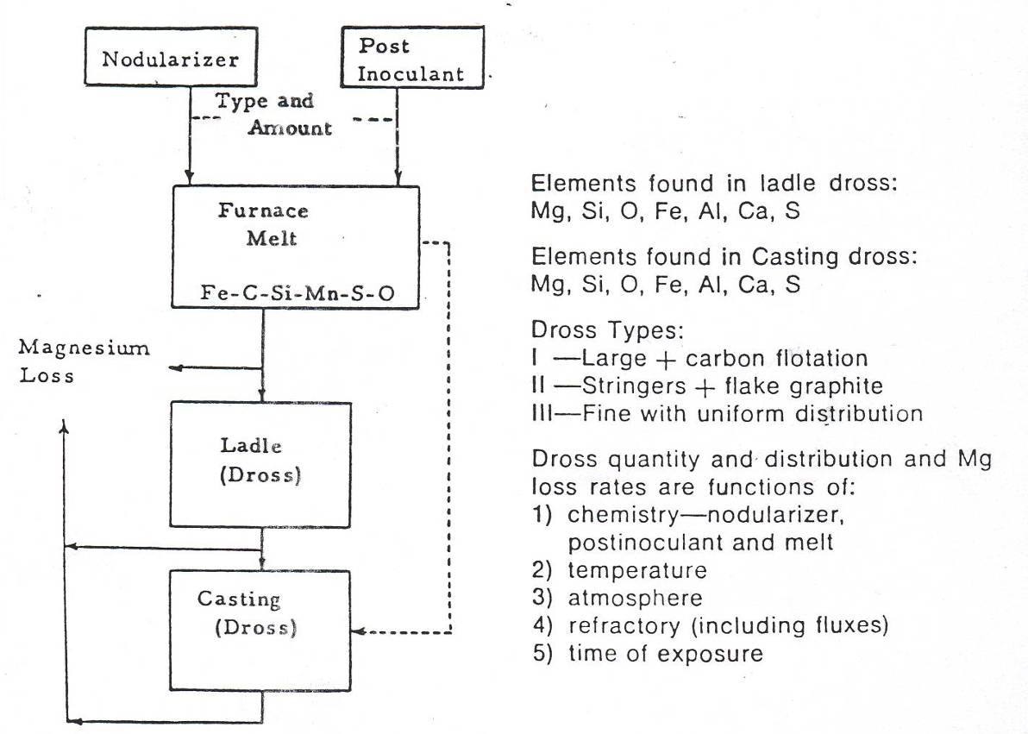
Flowchart of Sources and Compositions of Dross Produced in Nodular Iron

Slide 19
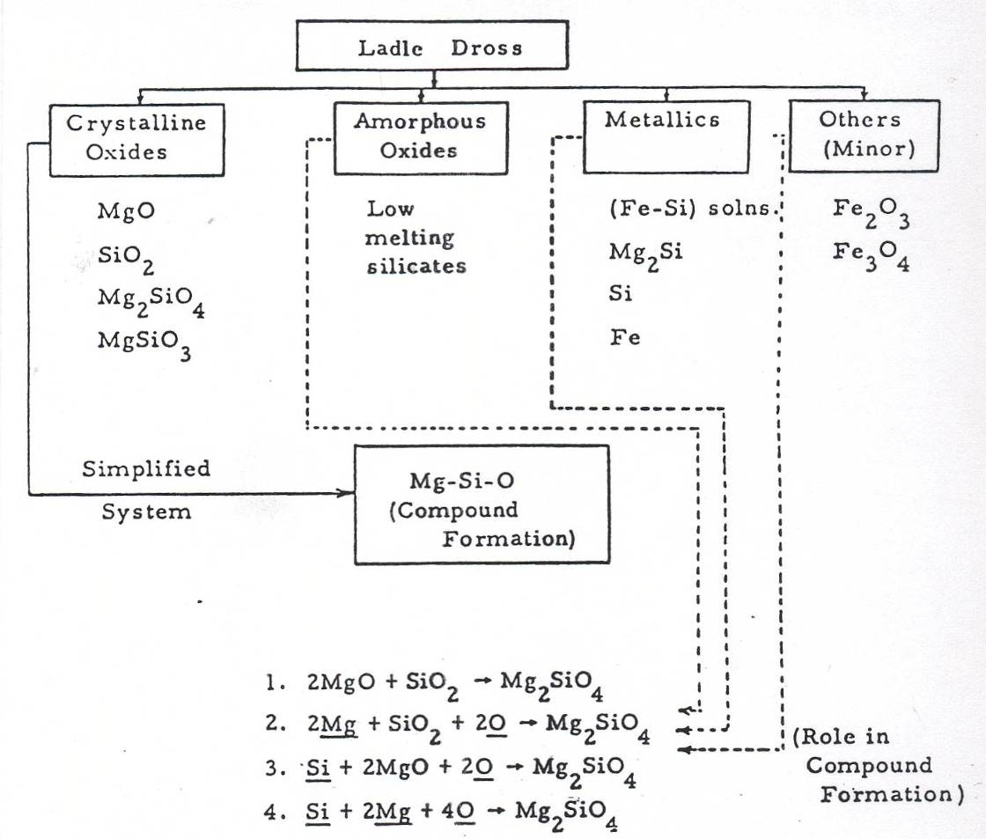
Schematic of the Classification of Ladle Dross
(Oxygen in these reactions should also be in the gaseous form, reaction 4 is highly importable)

Slide 20
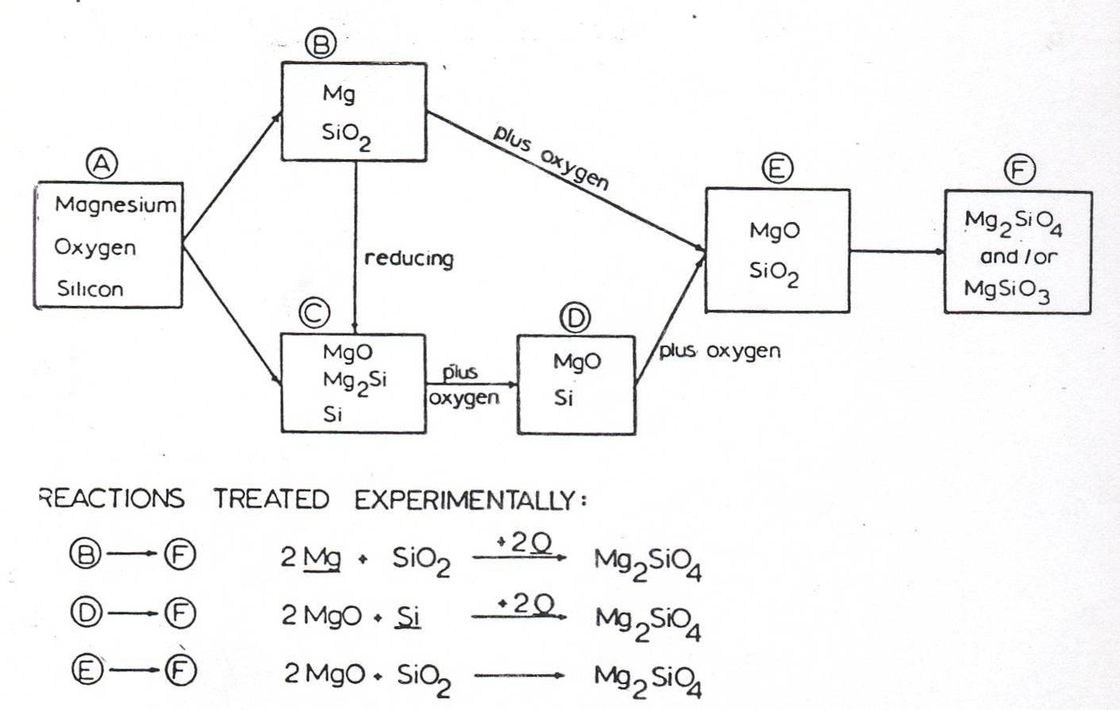
REACTIONS TREATED EXPERIMENTALLY:
Sequential Reactions which may be Take Place in the Mg-Si-O System

Slide 21
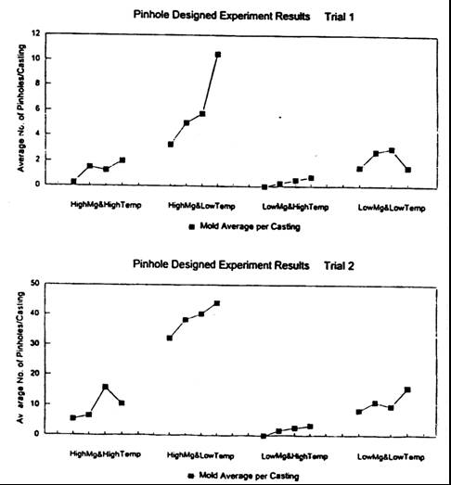
ROLE OF MAGNESIUM AND POURING TEMPERATURE
High magnesium content with low pouring temperature drastically increase the pinholes.
It is best to keep pouring temperatures high and Mg-levels low to minimize the reactive pinhole type.

Slide 22
OTHER PROCESS VARIABLES
Base Si-content
Increasing the base Si-content to over 1.5% reduces the magnitude and frequency of the high percent defect periods.
Low % Si greatly increases reoxidation to FeO in the metal handing system and, thus, produces more of the fluid reactive slag and subsequent pinholes defects.
At flotation carbon equivalent CE, the iron precipitates its excess of oxides along with C, slag initiation, dross formation and reoxidation occur as a result.
The dross or slag material was found to contain significant amounts of forsterite, enstatite the dross of the bulk slag and fayalite (the pinhole reactive slag).
Carbon Equivalent

Slide 23
Superheating and Pouring Temperature
Both low and high pouring temperatures have been reported as increasing pinholing.
Increasing superheating temperature over about 1480°C is usually accompanied by more extended reoxidation temperatures and time during pouring and the associated reoxidation slags.
Casting Configuration and Gating
Mold cavity geometry can provide locations where slag in the iron can accumulate.
Horizontal sections that fill slowly are particularly subject to reactive slag pooling and pinhole or gas hole formation.
Turbulent gating systems, which aspirate air and mold moisture add to these reoxidation slag accumulations.

Slide 24
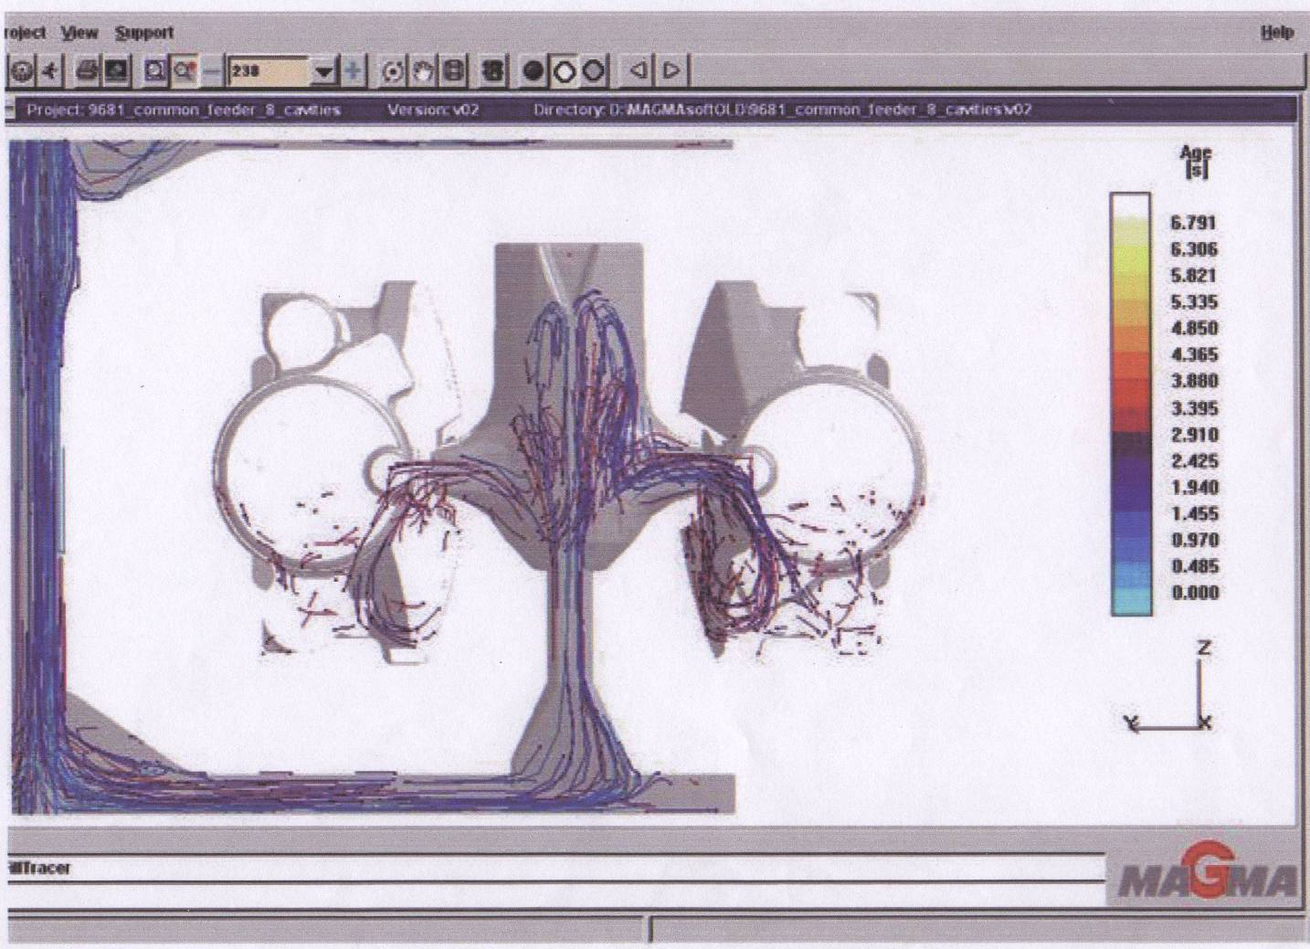
Mold Filling Simulation Showing Considerable Turbulence at Locations Identical with the Pinhole Formations

Slide 25
Effect of Pouring Temperature
It is difficult to state that an increase or decrease in pouring temperature will promote pinholing. The effect will vary depending on the section size and resultant solidification rate.
Proper combined conditions of gas pickup and solidification rate must be present for pinholes to form.
Higher pouring temperature: favors gas pickup in green sand, but also promote slow solidification rates that permit the gases to escape more readily.
Lower pouring temperature: result in less gas pickup and less evolved gas, but more rapid solidification rates can trap more gas near the surface before diffusion towards the casting interior or escape from the mold.

Slide 26
Corrective Action
Prevent slag from entering the mold cavity
Constantly monitor the critical areas for slag formation
Proper gating and runner design can be extremely effective
Avoid pouring cold metal
Monitor Mn and S-contents in iron

Slide 27
PROCESS PRECAUTIONS
Metallurgical processing to produce optimum quality iron must occur within the limits of the chemical principles described in the preceding discussions. To minimize adverse effects of oxidation, important practices can be observed:
  Charge Materials: Quality charge materials produce the best results, but may be more costly. Minimum surface rust and dirt is preferred, especially on thin scrap materials. Oxidized iron is a term long used by foundrymen to describe iron that causes unexpected casting results, such as excessive chill, carbides, gas holes, pinholes, metal penetration, unusual shrinkage, slag defects and others. Research attempts to relate these problems to iron oxygen contents are still going on.
  Temperature-time Cycle of Processing: Temperatures in excess of 1500°C extended melting, holding and pouring times promote more dissolved oxygen, total oxygen, and oxidation and reoxidation slags. Molten iron below 1400°C on a falling temperature should be better avoided.

Slide 28
PROCESS PRECAUSTIONS
(Cont’d.)
  Casting Geometry and Gating: Mold cavity geometry has been shown to provide considerable turbulence inside the mold at locations almost identical with the formation of the detected dross inclusions and the resulted pinholing defects. As it seems that there is little to do with the gating system and casting geometry, the use of ceramic filters may be considered. Use of filters will not only help in retaining any dross formations coming with the poured molten metal, but also will decrease any turbulence dictated by the casting configuration and/or gating system. Filters usually promote laminar flow. The type, porosity, dimensions of the filter as well as its location inside the gating system should be discussed in close collaboration with the filter supplier.

Slide 29
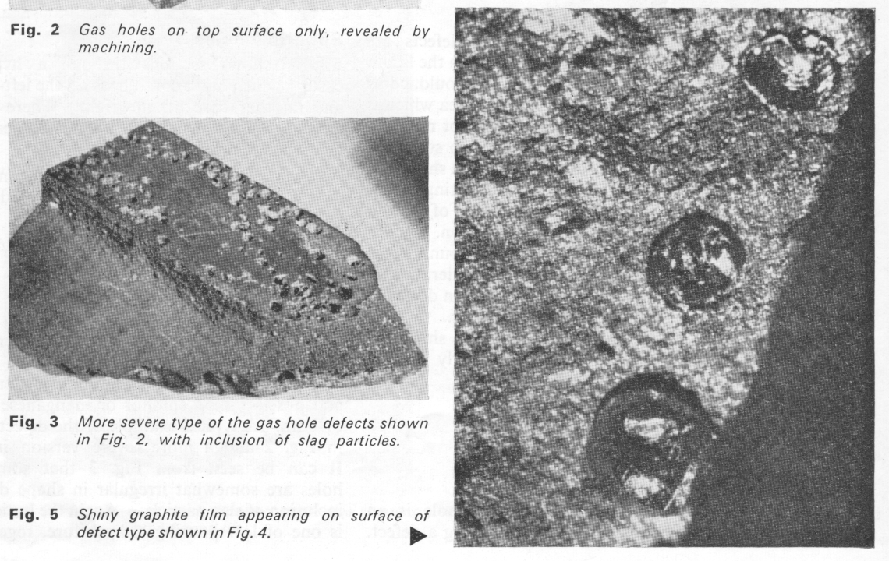
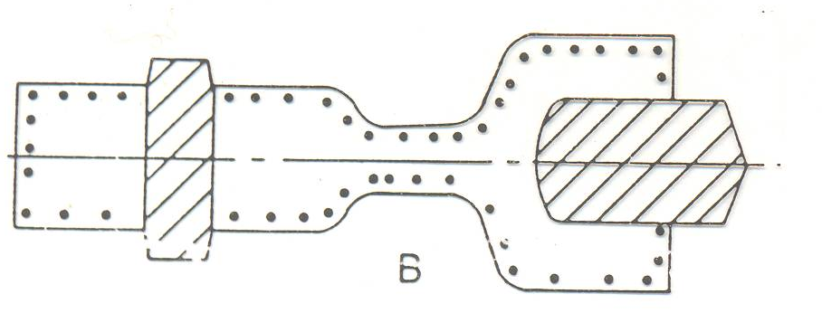
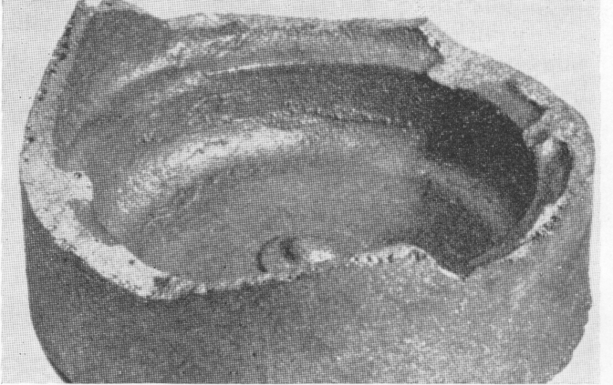
SPHERICAL HOLES
Hydrogen Pinholing
Form: small spherical holes on all faces of the casting adjacent to the mould – with shiny surfaces.
Causes:
Contamination of iron with Al.
Form:
- Scrap
- Inoculates
Too high moisture content in sand
Too long runner system
Shiny graphite film appearing on surface of defect type shown in previous figures.
Small, spherical holes with shiny surface occurring just below casting surface

Slide 30
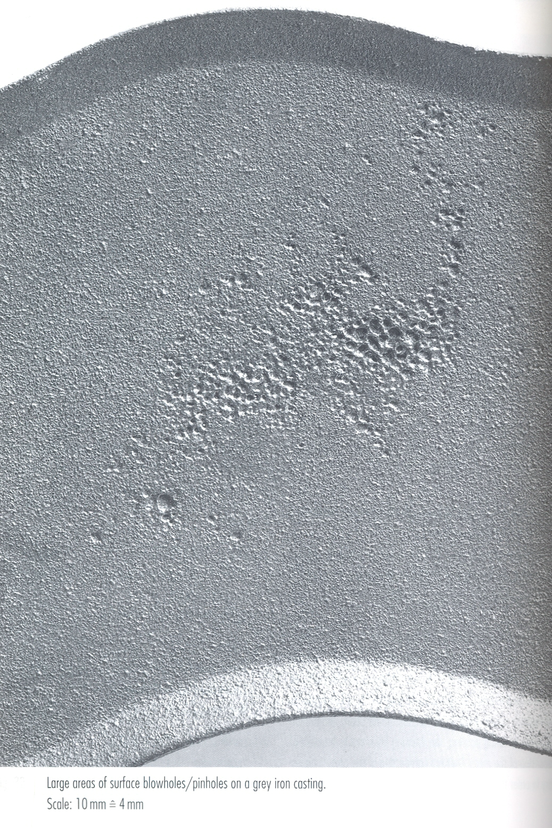

Slide 31
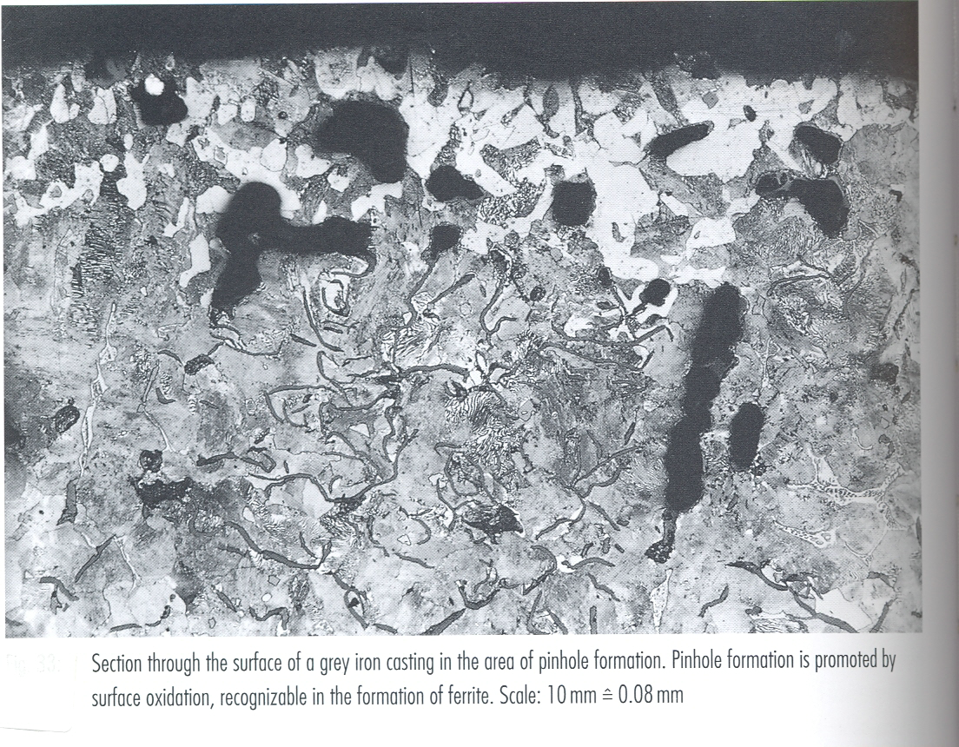
Section through the surface of a grey iron Casting in the area of pinhole formation. Pinhole formation is promoted by surface oxidation, recognizable in the formation of ferrite.

Slide 32
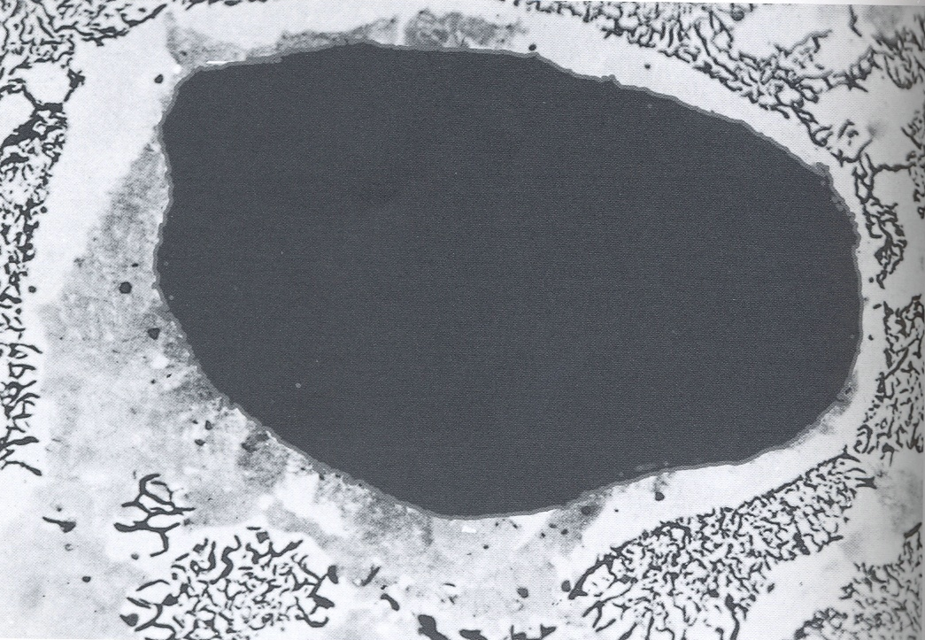
Section through the surface of a grey iron Casting, hydrogen-nitrogen defect recognizable by the graphite film and the partial decarburization of the surface zones.

Slide 33
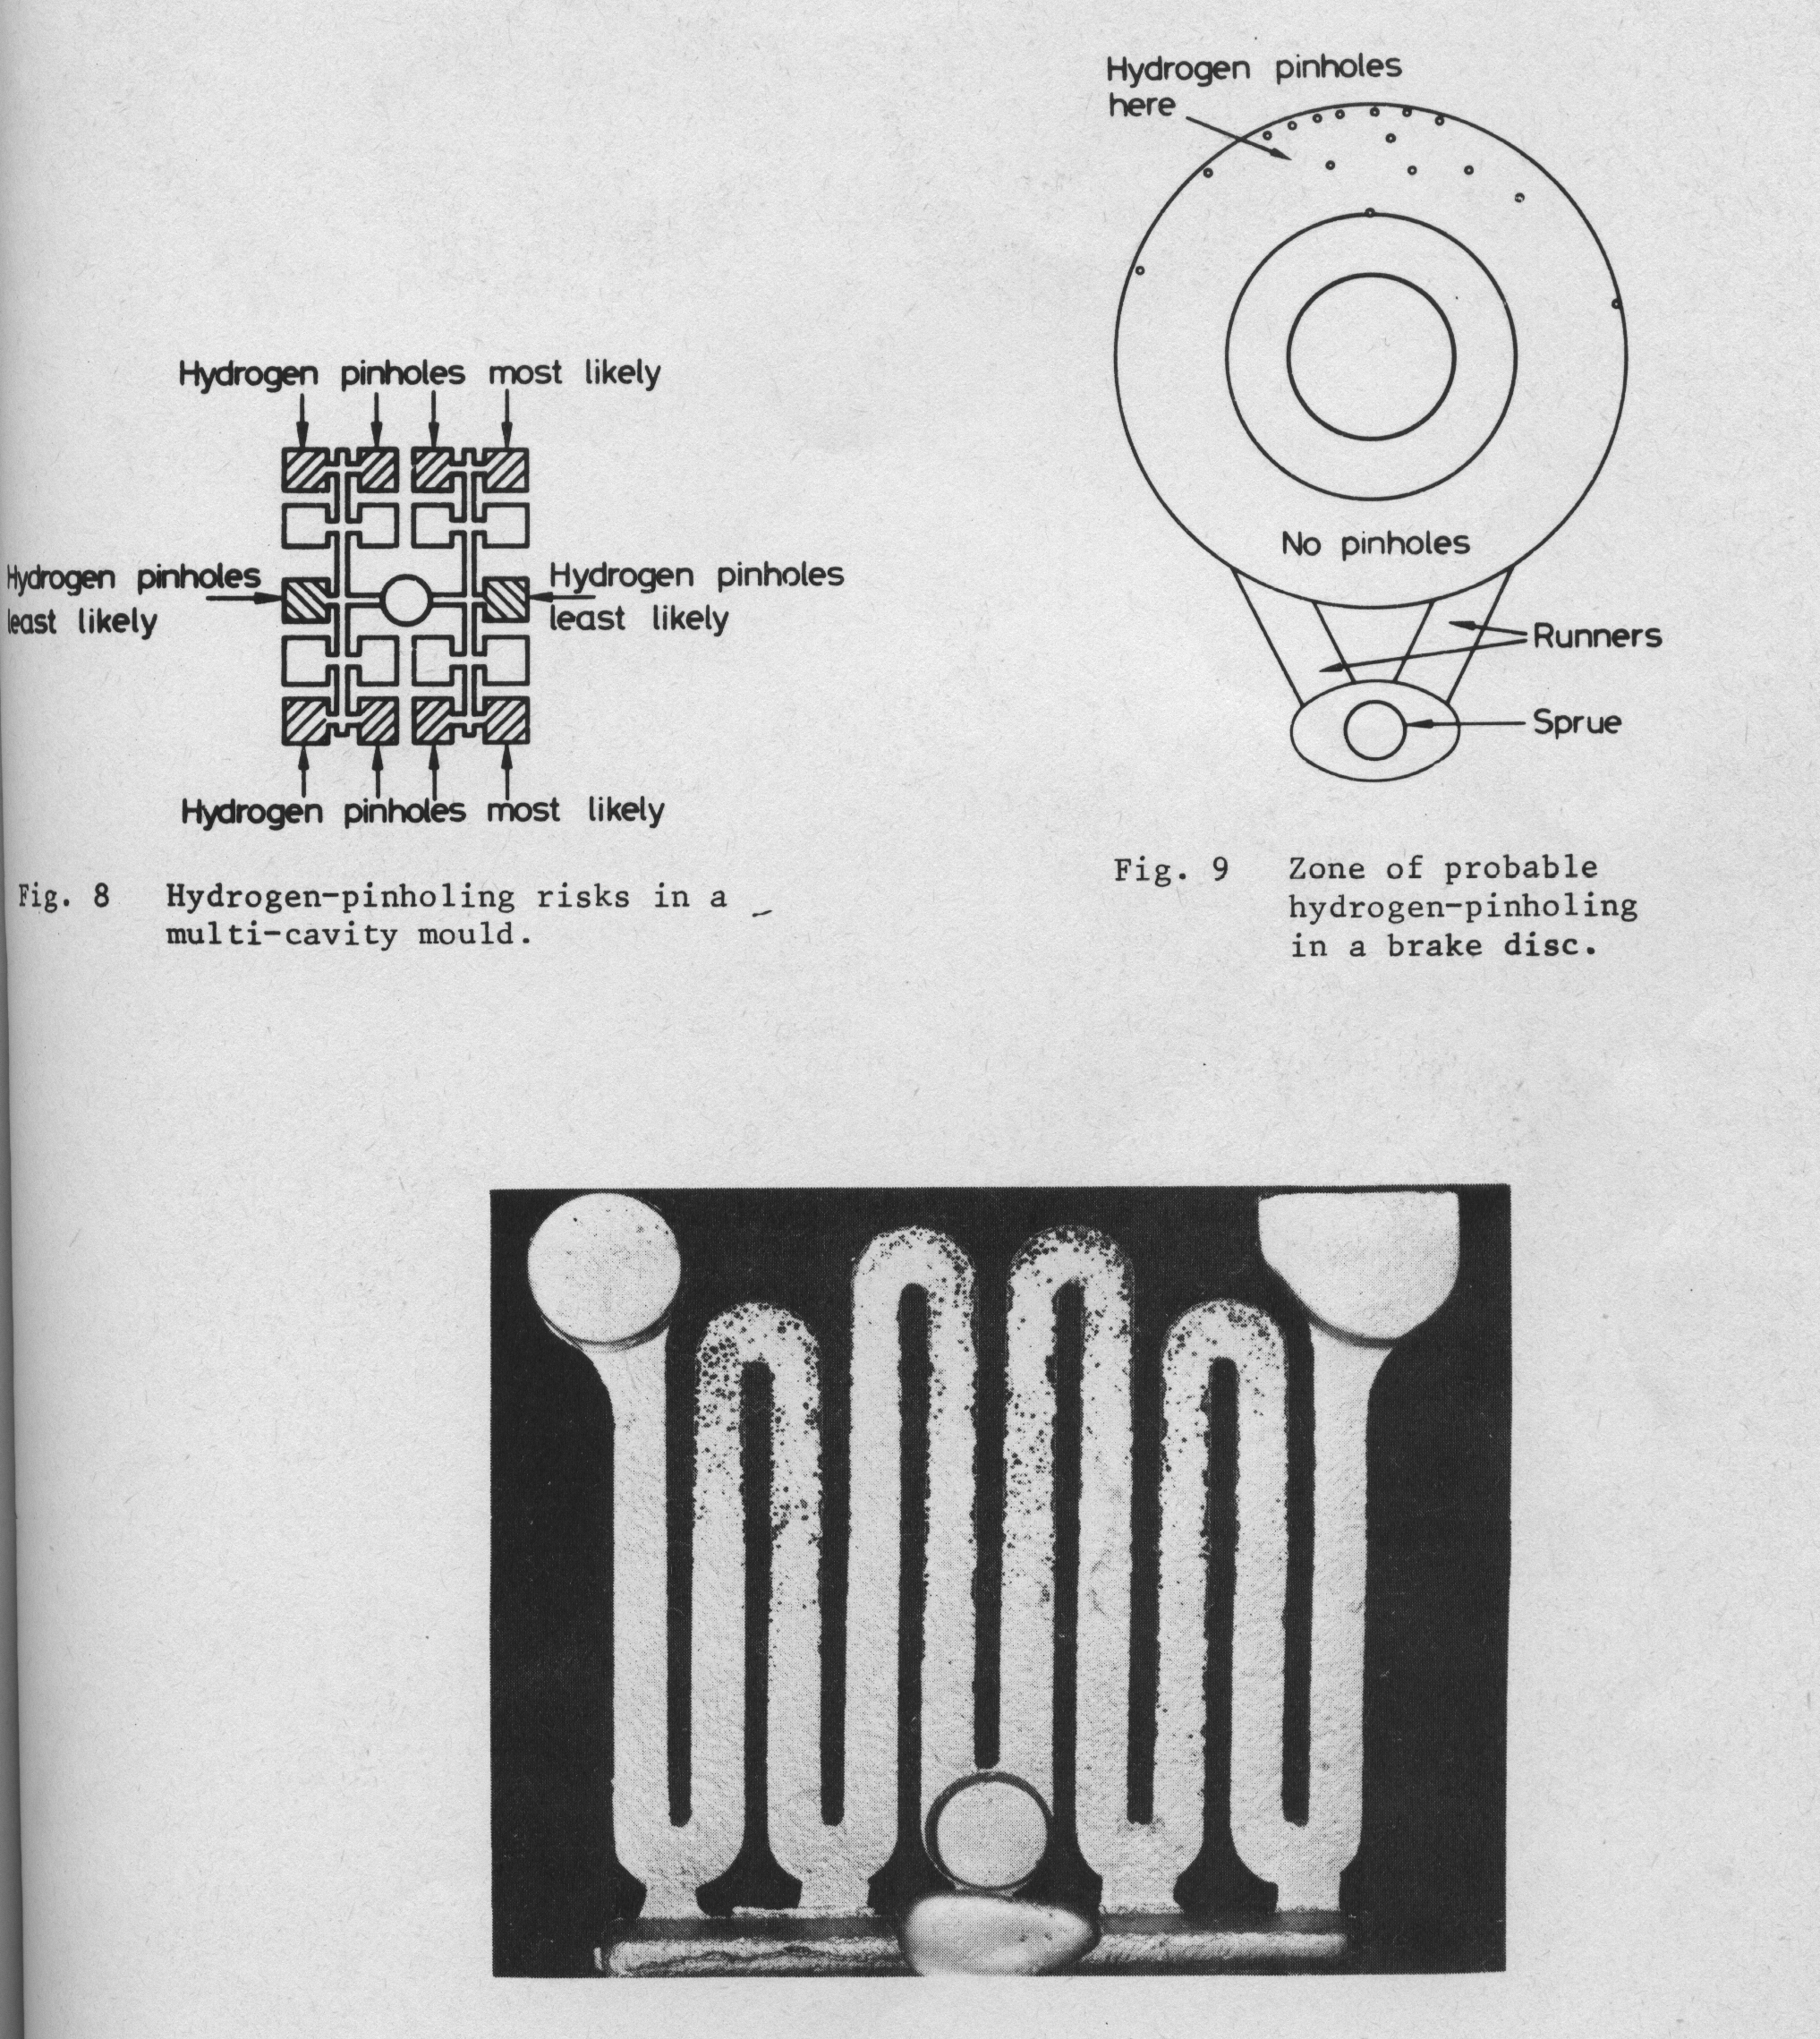
A practical example of this fact is illustrated, where severe pinholing has occurred in the area of the castings away from the gates, but no pinholes are present in the areas near to the gate. If, for example, the pinholes had occurred near to the gate, rather than farthest away, this would have indicated that the pinholes were very unlikely to be due to hydrogen pick-up and some other source of pinholing defects would require investigation.
Severe Hydrogen-pinholling, remote from gates.

Slide 34
PINHOLING IN CLAY-BONDED SANDS
Location of pinhole defects suggests that the primary mechanism is related to mold-metal interactions.
Gases form as a result of direct chemical reaction between the metal and mold constituents rather than from simple dissociation of water vapor.
The most likely reactions are:
C + H₂O → CO + 2 H
FeO + C → Fe + CO
The FeO is present because of the reactions,
Fe + H₂O → FeO + 2 H, and to a limited extent
Fe + ½ O₂ → FeO
The presence of strong deoxidizer in the melt can increase the available hydrogen further by such reactions as:
2 Al + 3 H₂O → Al₂O₃ + 6 H
and Mg + H₂O → MgO + 2 H

Slide 35
EFFECT OF Al-CONTENT
Presence of Al in the range of 0.015-0.20% promotes hydrogen pinholing in gray iron due to increased probability of reactions producing nascent hydrogen for dissolution in the iron.
In ductile iron, significant amounts of Al are often present due to additions of spheroidizers and inoculants. Nevertheless, the presence of Al does not always produce pinholing.
The effect of similar amounts of Al on pinhole formation in gray and ductile irons is significantly different
♦ may be associated with the presence of Mg
♦ both Al and Mg are strong oxide formers
- combine with dissolved oxygen or reduce less stable oxides
- formation of significant amounts of CO is unlikely and gas bubble nucleation becomes less probable

Slide 36
EFFECT OF Al-CONTENT (Cont’d.)
Al has a significant value in elimination of nitrogen-type pinholing by forming stable nitrides and effectively lowering the amount of atomic nitrogen in liquid metal:
Al + N → Al N
Late Al additions are preferable as early additions may lead to:
  Oxidation of Al
  Al₂O₃ may even promote pinholing by furnishing substrate particles for nucleation of bubbles

Slide 37
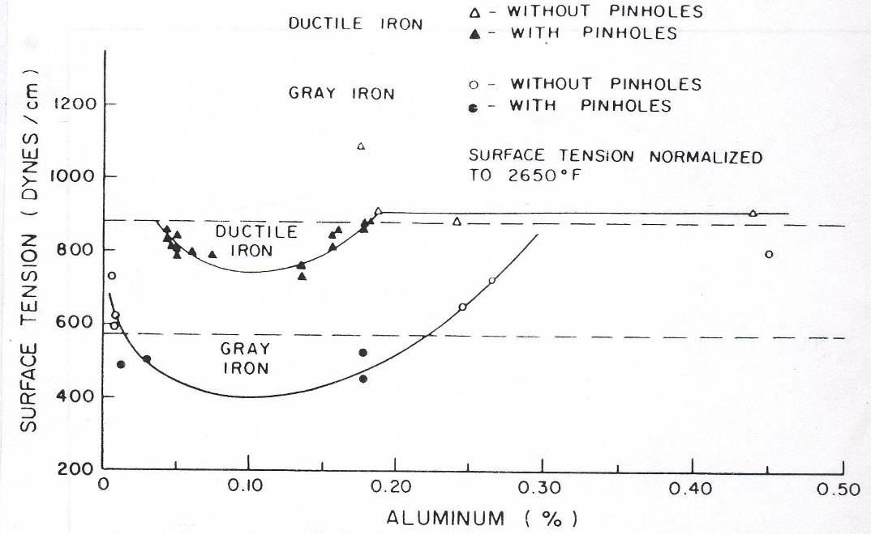
EFFECT OF Al-CONTENT (Cont’d.)
Effectiveness of large amounts of Al in limiting pinholing is explained as a diffusion-barrier phenomenon at the mold-metal interface:
  Limits hydrogen pickup
  Formation of Al₂O₃ with dissolved oxygen
Dependence of pinhole formation on Al-content in both gray- and ductile irons has been explained in the light of the influence of Al-content on the surface tension of molten iron.
The relative change in ductile iron is less because the influence that Al exerts on surface tension of iron containing Mg is lower-Mg already reaction with both O₂ and S and the increase in surface tension from higher Al-content is less.

Slide 38
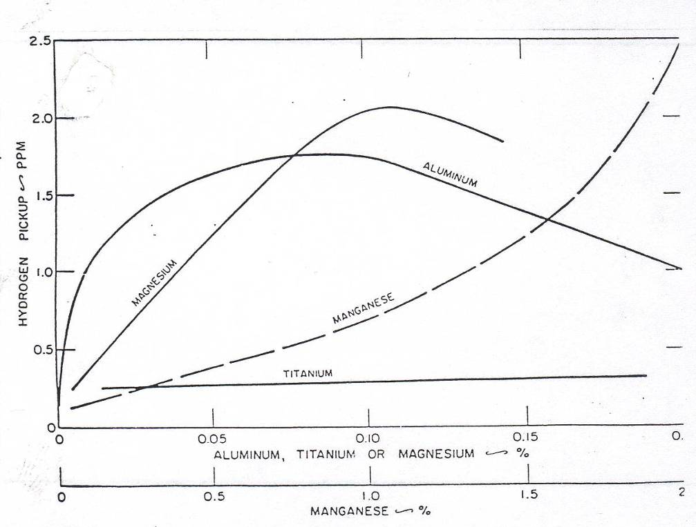
EFFECT OF Mg-TREATMENT ON PINHOLING
Much contradiction is noticed in the literature – may be due to:
  Mg-additions up to 0.1% increase the amount of hydrogen pickup from green sand, but in the same time:
  Mg increases the surface tension of molten iron which would decrease the probability of pinholing.
  Reduction of pinholing at high Mg levels has been explained by the formation of a diffusion barrier of MgO
  Mg-vapor in the form of bubbles may exert a flushing action on both N- and H-contents in the molten iron.

Slide 39
EFFECT OF Mg-TREATMENT ON PINHOLING (Cont’d.)
The relative effect of surface tension on the threshold value for pinholes to form in ductile, gray and white irons may also affect the formation of pinholes:
For ductile iron, the increased hydrogen pickup and/or more favorable nucleating conditions may enhance pinholing even at higher surface tension values.
In white iron, the lower threshold value of surface tension at which pinhole occur indicates:
  Lower hydrogen pickup and/or
  Less favorable nucleating conditions due to more rapid solidification rate

Slide 40
HYDROGEN-PINHOLING SUMMARIZED
Summarizing: we have hydrogen-pinholing caused by the pick-up of hydrogen from the moisture in the moulding sand. This hydrogen pick-up reaches pinholing levels when a trace of aluminum is present in the metal, and therefore it is imperative to avoid contamination by aluminium as far as possible.
All metal scrap must be inspected carefully for the presence of any aluminium-alloy parts or clippings, and the use of ferroalloy additions containing significant quantities of aluminium must be kept at a minimum level.
Damp pouring-equipment must be avoided, and the moisture content of the mould sand should be kept to a minimum level, while the volatile matter or live-coaldust content of the sand must be maintained at an adequately high level.
Long running-systems should be avoided, and if an outbreak of pinholing occurs in areas of the casting remote from the sprue there is every likelihood that the cause of the outbreak is hydrogen pick-up from the mould as a result of some contamination by aluminium.

Slide 41
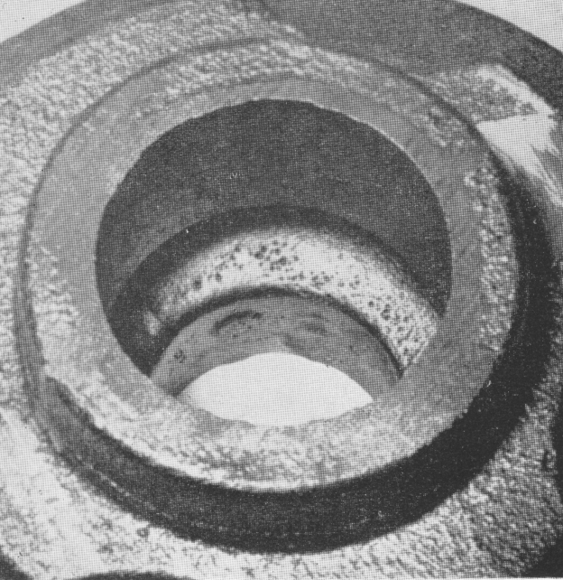
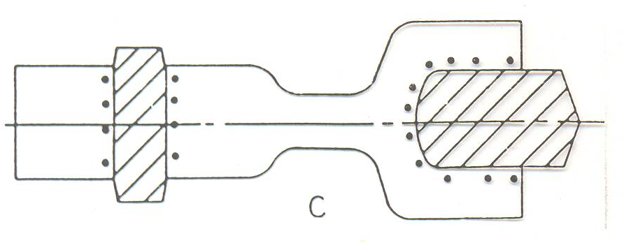
SPHERICAL HOLES
Nitrogen Defects
Form: small spherical holes (sometimes more elongated) adjacent to cores
Causes:
Nitrogen containing binders
Too much addition of resin
Too high N₂-content in resin
Occurrence of small spherical holes adjacent to core, often revealed immediately after knockout

Slide 42
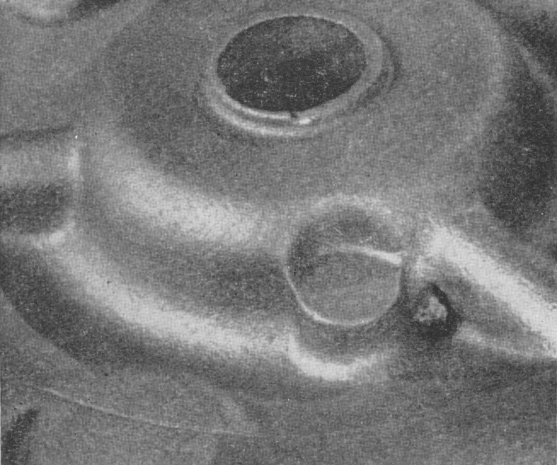
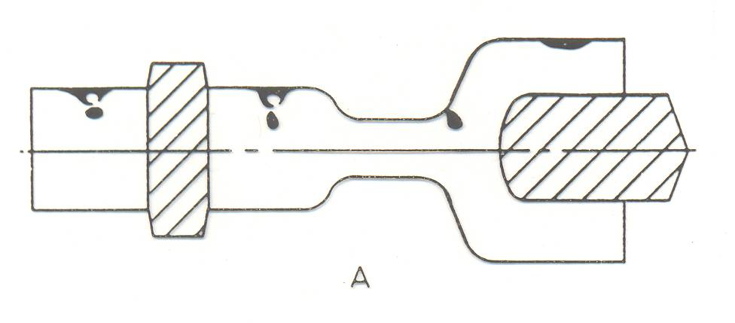
ROUNDED HOLES
Shrinkage Defects
Surface depression occurring at hot spot
Form: surface sink often with exuded bead of metal inside them or small depressions at hot spots with associated subsurface hole
Causes:
too low mold rigidity causes yielding under ferostatic or solidification pressures
too high pouring temperature
too low carbon content

Slide 43
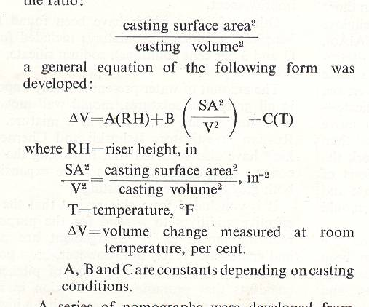
Statistical analysis has been used to calculate the extent of mould wall movement occurring with nodular and flake graphite irons, aluminum bronze, naval gun bronze, white irons and steel cast in greensand and dry-sand moulds. Using data concerning the feeder head size, the pouring temperature and the ratio:
a general equation of the following form was developed:

Slide 44
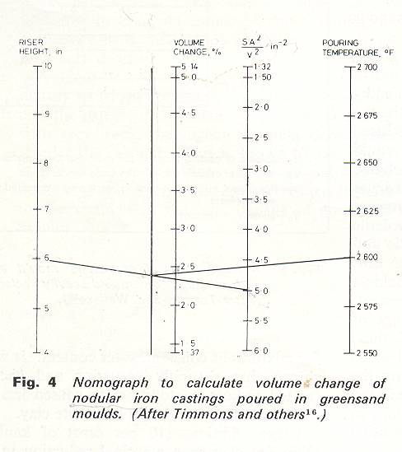
A series of nomographs were developed from this equation and an example is reproduced in Fig. 9 applying to the production of nodular iron castings poured in greensand moulds. For example for a nodular iron casting with SA²/V² ~ 5.0, pouring temperature 2600°F, with a riser, of 6 in height, the volume change resulting from mould wall movement is 2.4 percent.

Slide 45
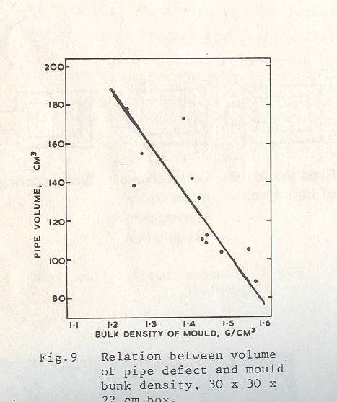
SAND COMPACTION
The harder a mould is rammed, the higher the bulk density obtained and the less the mould-wall movement occurring – and consequently, the sounder the casting obtained. This is illustrated by the relation between the mould bulk density and feeder-head pipe volume in nodular keel blocks made in greensand moulds.
The data show that the pipe volume decreases from 180 to 80 cm³ as the greensand mould density rises from 1.25 to 1.6 g/cm³ with firmer ramming of the moulds.

Slide 46
SUMMARY OF METHODS OF REDUCING MOULD-WALL MOVEMENT AND IMPROVING CASTING SOUNDNESS
Use greensand mixtures with low water content.
Make an addition of coaldust or pitch to the sand mixture.
Run moulds to high and uniform bulk densities.
Ensure that moulding machines are not overloaded, and are operated at the correct air-line pressure.
Avoid pouring castings too hot.
If possible, avoid placing tall feeder heads on castings.
Weight moulds so that the load is distributed as evenly as possible.
Use boxes with adequate reinforcing bars, and ensure that the sand between the bars is well compacted.
Use strong boxes containing sufficient sand to prevent the boxes distorting from heat and deforming the moulds while the castings are solidifying.

Slide 47
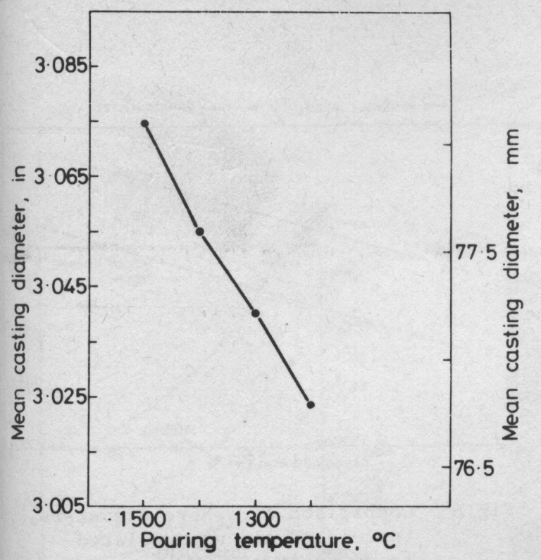
(1) Pouring-Temperature
High pouring-temperatures cause shrinkage in grey irons for two reasons:
  Increased contraction of liquid metal occurs in cooling to the temperature at which solidification commences;
  Greensand moulds are not dimensionally stable under the action of heat, and for this reason the extent of mould-wall movement increases with rise in pouring-temperature.
The effect of pouring-temperature on casting size. Increased pouring-temperature produces castings which are oversize; and the greater the amount of over-sizing of a casting, the greater will be the volume of unsoundness.

Slide 48
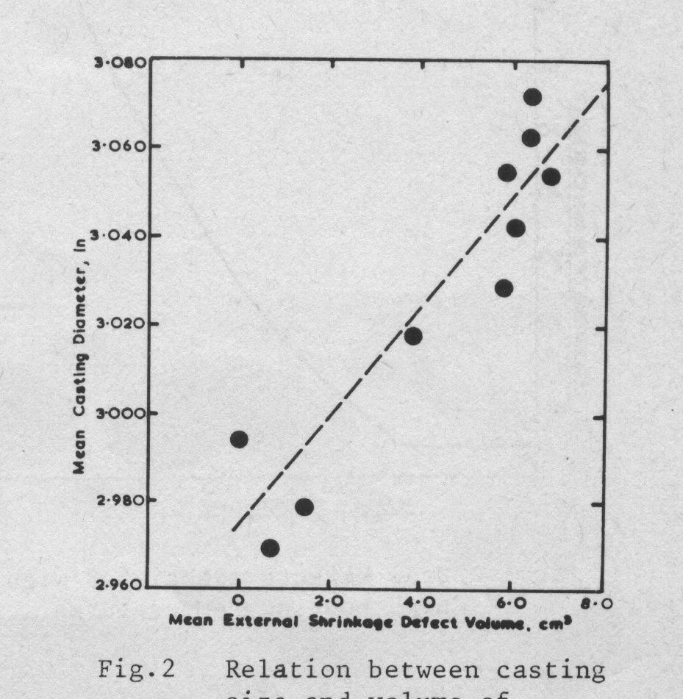
The effect of casting size on the degree of soundness. An example of the association between the pouring-temperature and the degree of shrinkage defect was provided by an investigation into the cause of shrinkage in cylinder-head castings. The castings were produced in a large mechanized foundry having numerous pouring-stations – all supplied from the one cupola..

Slide 49
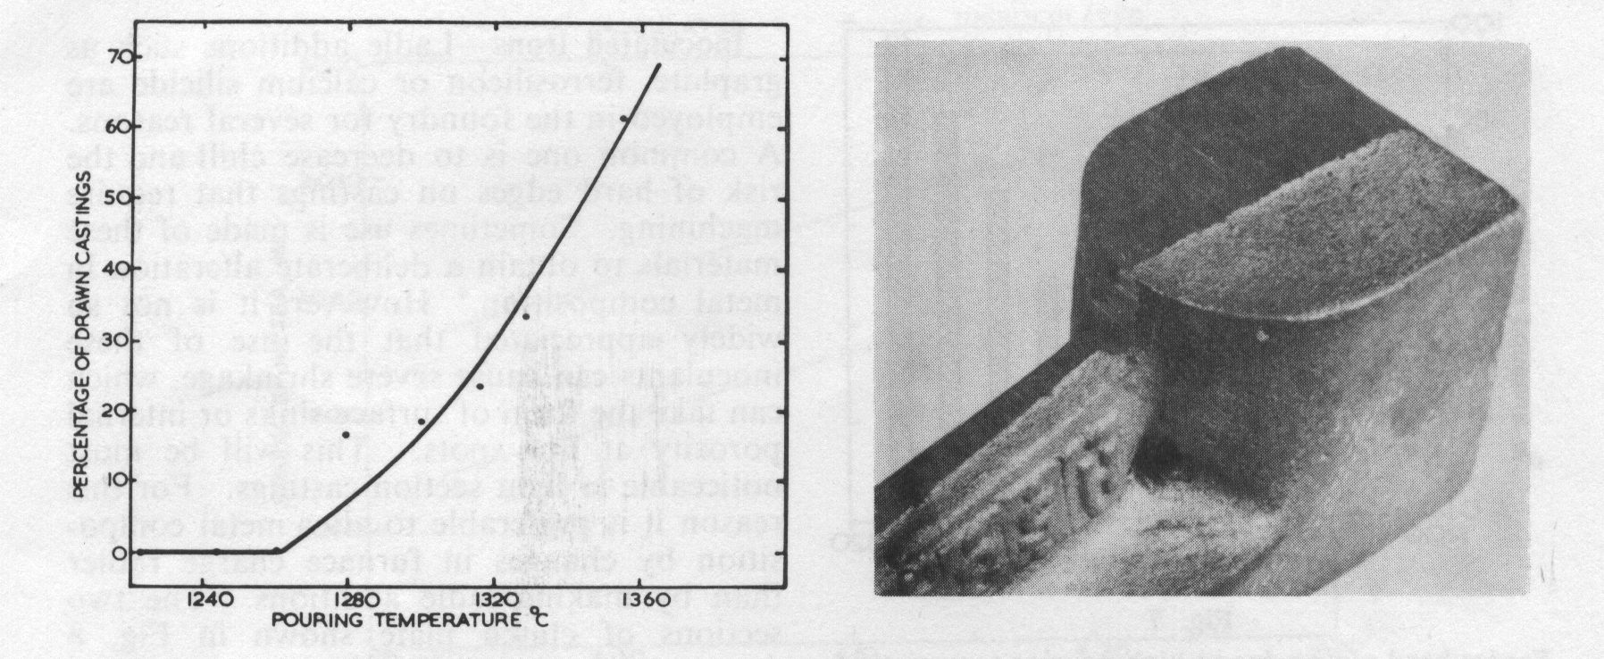
Draw defects associated with high pouring temperatures
The above two examples refer to internal-porosity defects revealed on machining. Pouring-temperature can also affect the formation of draw-type or surface-sink defects.
The relation between pouring-temperature and the proportion of ‘drawn’ castings:
At a temperature of 1360°C, 60 percent of the castings contained draw defects; and as the pouring-temperature was reduced, the proportion of sound castings increased until, with pouring-temperatures of 1260°C and below, complete freedom from these defects was obtained.

Slide 50
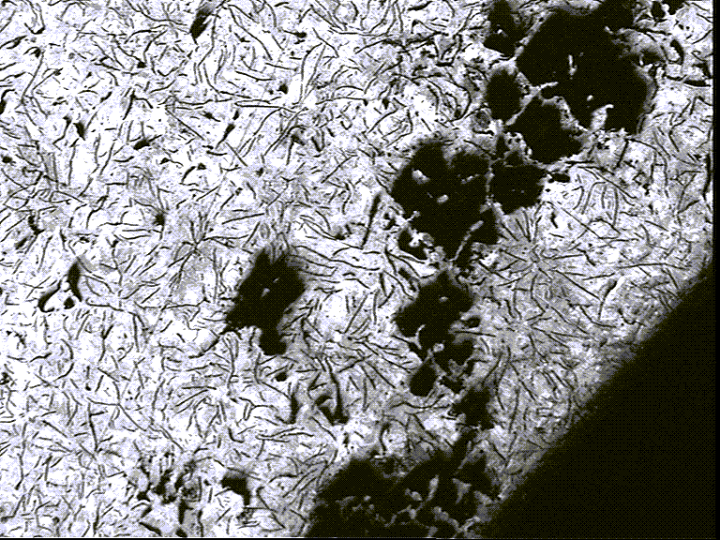
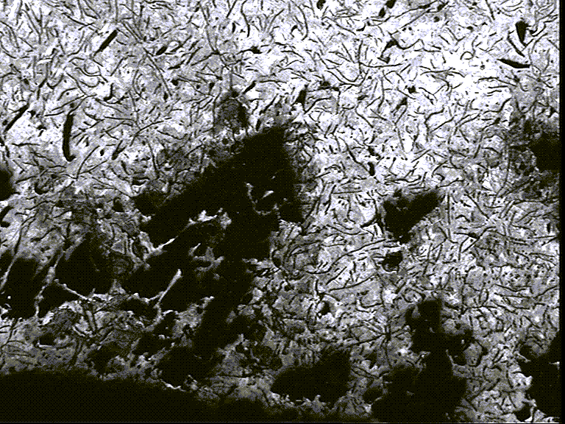
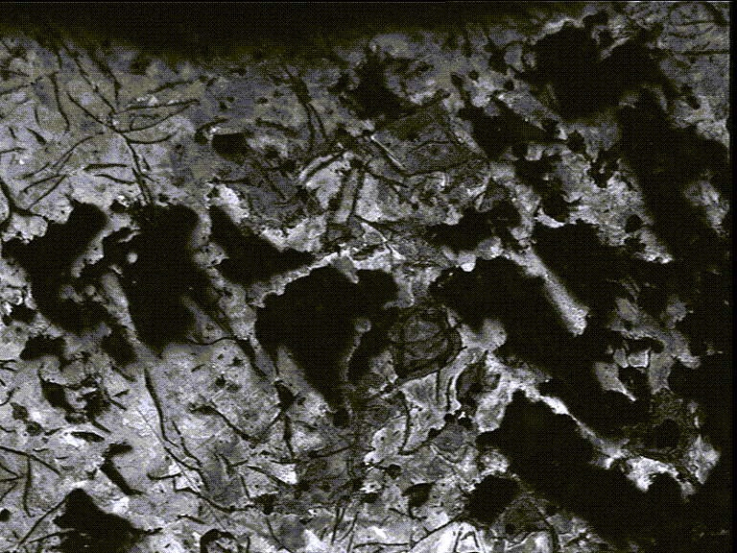
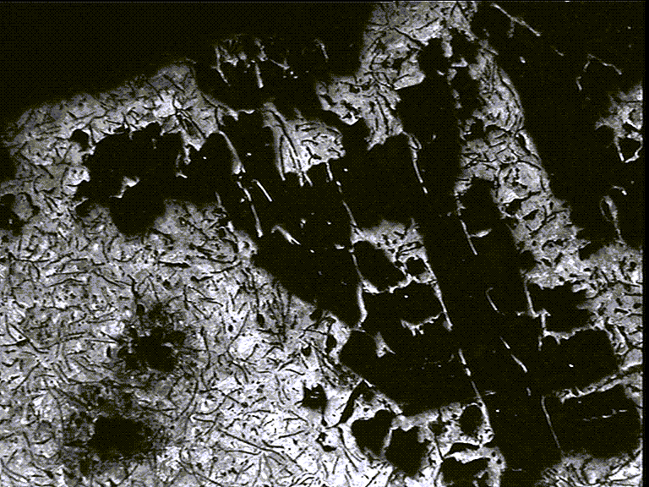

Slide 51
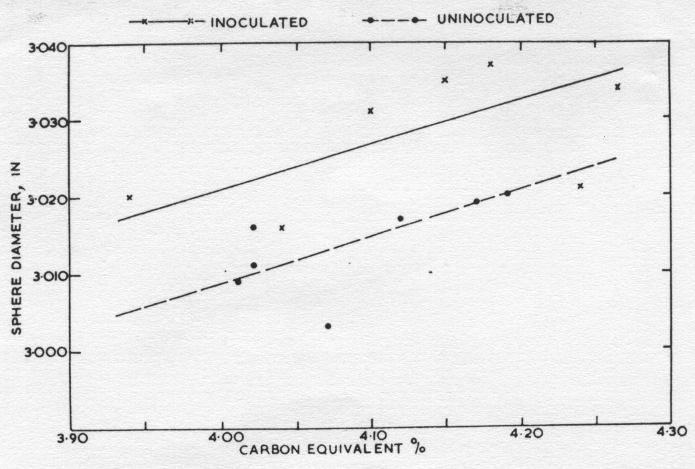
(2) Degree of Nucleation
Ladle additions such as graphite, ferrosilicon or calcium silcide are employed for several reasons, the most common one being for the reduction of chill and hence to maintain machinability of castings.
Inoculation treatment may also be used to promote a certain type of graphite structure, and thus improve tensile properties. It is not widely appreciated, however, that the use of inoculants increases the tendency for shrinkage defects to occur.
Comparison of dimensions of
Inoculated and uninoculated castings.
At a constant carbon-equivalent content, the dimensions of the inoculated castings are greater than those of the uninoculated castings. This is true for the range of carbon equivalent values from approximately 3.9-4.3.
It has previously been shown that any factor resulting in the production of oversize castings will also result in a tendency for more unsoundness to occur.

Slide 52
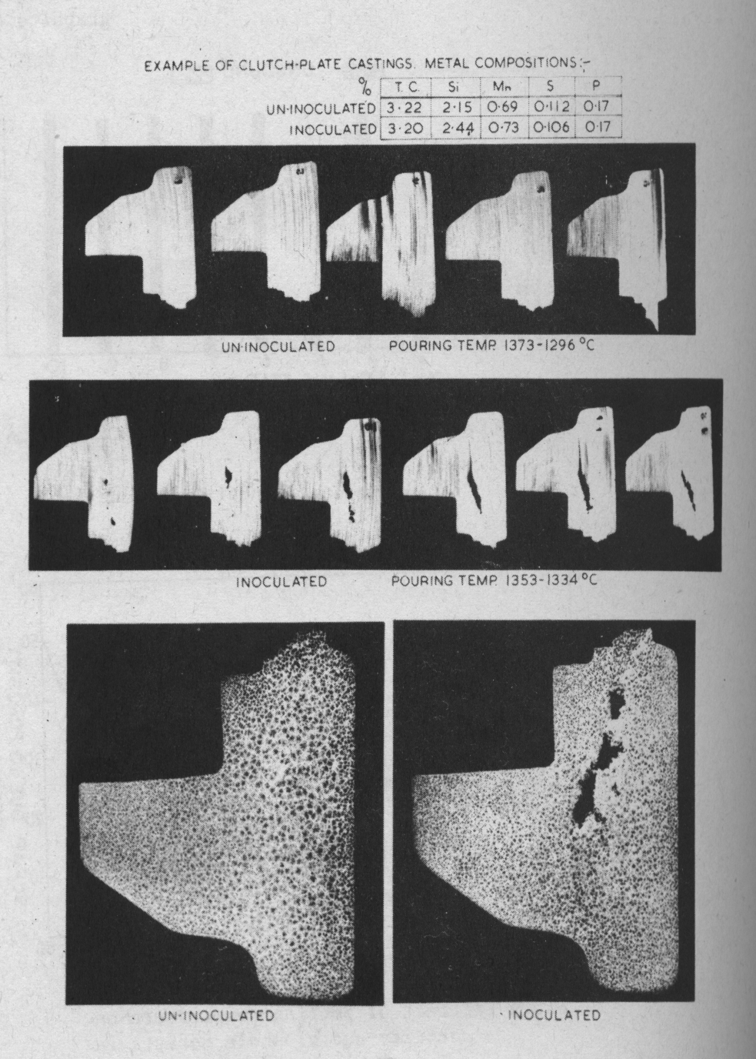
This figure gives results of an investigation dealing with porosity problems in automotive clutch-plates which were produced from irons having high degrees of nucleation – as a result of additions of 0.3 percent silicon as ferrosilicon.
The inoculation treatment was made, to maintain machinability standards on the free edges of the castings, but was subsequently found to be unnecessary.
Thus castings which were inoculated had a very high risk of containing porosity in the bosses, whereas castings produced from uninoculated irons were sound.
Porosity in clutch-plates due to inoculation.

Slide 53
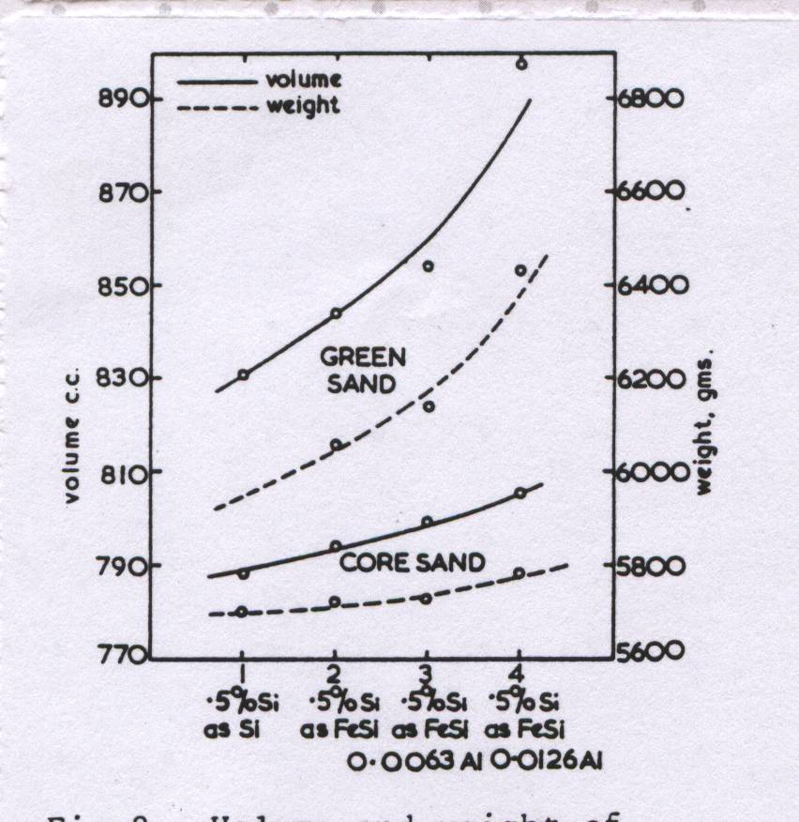
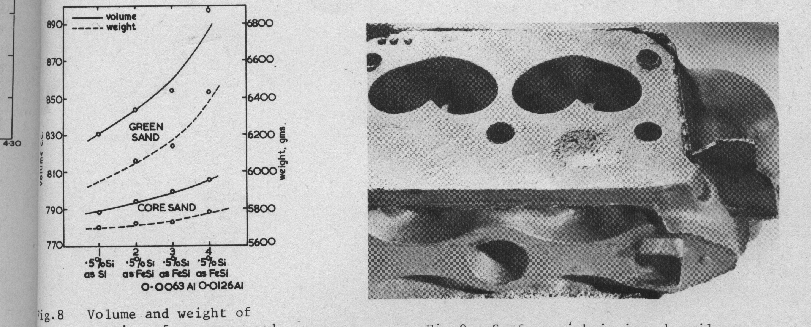
Inoculants which have a profound effect in increasing the nucleation of the iron have a similar effect on soundness, i.e. high-aluminum ferrosilicon increases the degree of nucleation of an iron to a greater extent than pure ferrosilicon.
Different inoculants therefore have differing effects on the amount of mould-wall movement and the subsequent soundness of castings. This is illustrated in Fig. 8. Graphite is a particularly potent inoculant, and if used in excessive quantities can promote severe outbreaks of shrinkage defects.
Illustrates a severe surface sink in a cylinder-head casting produced from iron heavily inoculated with graphite. It is important to use only the minimum amount of inoculant required to control chill, so that machinability standards are maintained.
Inoculants are expensive materials, and have disadvantages from the soundness point of view if used excessively.
Volume and weight of castings
from green and core sand moulds.
Surface sink in iron heavily inoculated with graphite.

Slide 54
Metal composition
In steel castings shrinkage defects arise due to a solidification contraction. However, in grey cast irons defects such as surface pipes, sinks, internal cavities and porosity are associated with a general expansion of the casting which occurs during the solidification processes. Much of this expansion is associated with formation of the austenite-graphite eutectic.
The composition of this eutectic is controlled by the carbon, silicon and phosphorus contents of an iron and for this reason the carbon equivalent formula:
Carbon equivalent % = total carbon % + 1/3 (silicon % + phosphorus %)
is very convenient index of metal composition.
When discussing the influence of metal composition on soundness the section thickness of the castings must be taken into account.

Slide 55

(a) Light section casting
Light section castings, where the ruling section thickness is less than ½ in.
As many producers of light section grey iron castings are aware maximum soundness in such castings is achieved with irons of approximately eutectic composition, i.e. carbon equivalents of 4.3 percent. shows that surface sinking is at a minimum with eutectic composition irons and that either an increase or a decrease in the carbon equivalent content will produce shrinkage.
In cases where the carbon equivalent is too low it is preferable to raise the carbon content in preference to the silicon content.
Such alterations are best made by alterations to the furnace charge and not by late ladle additions. When shrinkage is experienced because the carbon equivalent is too high it is preferable to lower the silicon content.
Minimum shrinkage at eutectic content.

Slide 56


(b) Medium and heavy section castings
As the section size increases the problem of ensuring dimensional accuracy and soundness becomes more acute. The heavier the section size the greater is the tendency for casting expansion to occur with the attendant risk of unsoundness.
In unfed 4 in cubes it has been shown that the severity of internal porosity rises as the carbon equivalent content of the iron increases. Direct measurement made on similar castings has shown that as the unsoundness rises there is an increase in the physical dimensions of the casting.
Internal porosity, as shown when occurring in medium and heavy section castings is frequently caused by the carbon and carbon equivalent content of the metal being too high.
Relationship of carbon equivalent content to internal porosity of cast iron.
Internal porosity in heavy section.

Slide 57
An example of dispersed porosity in heavy section castings due to high carbon and carbon equivalent contents was provided by a flywheel of composition:
percent
Carbon equivalent 4.60
Total carbon 3.60
Freedom from porosity in this casting was achieved with a recommended composition of:
percent
Carbon equivalent 4.20
Total carbon 3.30

Slide 58

Porosity in cylinder heads due to hot metal.
The results of indicated that the pouring stations nearest the cupola were responsible for most of the porous castings, some of the stations producing 75 percent scrap.
As expected, the station nearest the cupola had the highest pouring-temperature and the station most remote from the cupola, the lowest pouring-temperature.
Pouring-temperature in this instance, therefore, was shown to have a direct bearing upon the incidence of defects in the cylinder-heads, the highest temperature promoting the highest incidence of porous castings.

Slide 59

Effect of pouring-temperature on porosity and blowhole defects in cylinder-block castings.
Illustrates the effect of pouring-temperature on the incidence of porosity defects in cylinder-block castings. It can be seen that castings poured at above 1420°C contain porosity defects; and that at temperatures as high as 1460°C, 50 percent of the production was rejected owing to porosity defects.

Slide 60



ROUNDED HOLES
Gas Blowholes from Cores, Molds, or Inserts
Blowholes in plate casting
Causes:
Excessive moisture content of sand
Vents of cores are blocked
Cores are underbaked or with excessive binder content
Rusty or contaminated chills (denseners) or chaplets
Blowholes in cored casting resulting from metal entering core vent. The metal extracted from the core vent is also shown.

Slide 61


Low-alloy grey iron casting. Formation of surface blowholes in the top part.
Formation of a large blowhole in the top of a grey cast iron radiator.

Slide 62


Slide 63



IRREGULAR HOLES
Gas Defects from Molten Iron
Larger, isolated fissure defects
Form: discrete fissures rather than areas of interconnected open metal may be widely dispersed or more isolated
Causes:
Too much gas content in molten iron
The more widely dispersed holes are due to N₂
The more isolated cavities are due to high H₂ - content
Widely dispersed fissure defects

Slide 64


Slide 65


Slide 66


Slide 67
(B) NITROGEN DEFECTS
During the past 25 years the iron-founding industry has seen considerable technological changes. There has been a tremendous increase in the use of synthetic resins for mould and core production, in adhesives and mould coatings, and many of these resins contain nitrogen.
In molten-metal production there has been a gradual reduction in the use of pig iron and there has been a corresponding increase in the use of steel scrap, in both cupola and electric-furnace melting.
These changes in mould, core and metal production have brought with them problems associated with nitrogen gas in the form of pinholes and fissure-type defects, which are generally not revealed until expensive and costly machining operations have been carried out.
Molten cast iron is capable of dissolving nitrogen, and if large quantities are present, on solidification the gas rejected is in the form of either pinholes or fissures. Some of the nitrogen may be retained in the solidified iron, which can promote pearlite formation and also contribute to some marked improvement in tensile properties.
These advantages are particularly marked in high-grade cast irons produced from high-steel-scrap charges, and the presence of nitrogen is therefore beneficial.

Slide 68

This figure illustrates a gross form of the defect resulting from high nitrogen content in the iron.
There are two areas of casting production where nitrogen may be picked up by the liquid metal:
  during the melting process;
  during the flow of liquid iron in the mould cavity
Gross nitrogen-fissure defects.

Slide 69

HOW MUCH NITROGEN ?
Normally, nitrogen fissure defects are not encouraged in castings produced from irons having nitrogen contents under about 90 ppm.
The incidence of fissure defects increases very markedly as the nitrogen content increases above 100 ppm. This is illustrated.
Nitrogen content v. incidence of fissure defects.

Slide 70


IRREGULAR HOLES
Shrinkage Defects
Form:
open metal, often interconnected areas
has a dendritic form
generally occurs in the heavier sections or hot spots such as positions adjacent to ingates or risers
Causes:
lack of mold rigidity
high pouring temperature
over inoculation
high phosphorous content
Micrograph illustrating dendritic form of internal porosity

Slide 71


Slide 72



Slide 73

TYPES OF SHRINKAGE DEFECTS IN IRON CASTINGS
In principle, the total shrinkage formed in a casting, after solidification, is made of the following: 1) the concentrated shrinkage (shrinkage cavity), 2) the dispersed macroshrinkage and 3) the dispersed microshrinkage (or microporosity).
Schematic drawing showing definition of concentrated and dispersed shrinkage in an open casting.
Notes:
73

Slide 74

THE DISPERSED MACROSHRINKAGE
The dispersed macroshrinkage is of millimeter size and consists of cavities that resulted from lack of feeding during solidification.
Notes:
74

Slide 75
The Dispersed Macroshrinkage
of millimeter size and consists of cavities that resulted from lack of feeding during solidification
mainly appears in heavy sections or at hot spots of the casting and could be eliminated through optimization of the riser design
appears either as isolated or as interconnected irregular cavities and can be observed with the naked eye on the cross section of the casting
the cavity walls are rough and appear as a black-grey honeycomb structure that follows the contour of dendrites
Notes:
75

Slide 76
The Dispersed Microshrinkage
(or Microporosity)
usually dispersed in the whole cross section of a casting and consists of micron-size cavities that are formed between the eutectic grains or dendrite arms at the end of eutectic solidification
can be observed only under microscope magnification
is difficult to eliminate through common foundry practice, particularly in hypo-eutectic SG iron
Notes:
76

Slide 77
The dispersed microshrinkage must not be confused with macroporosity, which is the result of gas bubbling out of the solidifying metal. Macroporosity is, again, of millimeter size.
The relationships between selected metal and mold variables and the dispersed shrinkage (macro and micro) are discussed in this lecture. The main goal is to provide the foundryman with some guidelines for manipulation of metal and mold variables to decrease the occurrence of dispersed shrinkage in SG iron castings.
To understand the intricacies of the correlation between nodule count and dispersed shrinkage, one has to first comprehend the peculiarities of the mechanism of solidification of cast iron, as well as the mechanism of formation of dispersed shrinkage, in relation to mold behavior.
Notes:
77

Slide 78
Particularities of Solidification of SG Iron
Upon cooling from the pouring temperature to room temperature the iron casting will undergo significant dimensional changes as a result of a sequence of contraction and expansions:
contraction in the liquid state,
shrinkage during solidification (due to the liquid ⇔ austenite dendrites transformation),
expansion during solidification (due to the liquid ⇔ graphitic eutectic transformation)
contraction during solid state.
1 and 4 are a function of the expansion coefficient of the alloy
2 and 3 are the result of the density charge associated with the liquid-solid phase transformations
Notes:
78

Slide 79
Effect on Casting Dimensions
The final dimensions of the casting as well as the total shrinkage, will depend not only on the behaviour of the metal, but also on the behaviour of the mold
The mold will dilate because of the metallostatic pressure and the graphitization expansion
Mold dilation in SG castings is much more pronounced than in FG castings
Notes:
79

Slide 80

Why the mold dilation in FG irons is usually limited?
Eutectic FG iron solidifies with a relatively narrow mushy zone, as the eutectic grains form a skin at the mold/metal interface
This skin increases in thickness, by growing inward and prevents most of the eutectic solidification expansion from being transformed to the mold thus, considerable pressure is built within the casting when the feeding channels to the riser are closed
Feeding occurs easily at the eutectic liquid interface and, thus, no dispersed shrinkage is likely to occur until the very late stages of solidification (no liquid pockets, which could become regions of dispersed shrinkage are left behind the flat eutectic front.
Schematic illustration of solidification mechanisms of flake and spheroidal graphite cast iron.
Notes:
80

Slide 81
More dispersed shrinkage in SG irons – why ??
Eutectic SG iron solidifies with a relatively large mushy zone, rough liquid-eutectic interface, and with complex, austenite dendrite-graphite spheroid aggregate growing over most of the volume of the casting
Most of the pressure resulting from the eutectic solidification expansion is transferred to the mold, and very little pressure is built within the casting
The mold cavity expands, unless it is very rigid, thus canceling the benefits of eutectic expansion and a shallow pressure gradient exists within the casting
Because of the mushy nature of the eutectic morphology (rough liquid-eutectic interface) pockets of liquid may be entrapped deep into the solid regions – most likely, dispersed shrinkage will form in these pockets upon complete solidification
Schematic illustration of solidification mechanisms of flake and spheroidal graphite cast iron.
Notes:
81

Slide 82

The Difference in the Mechanism of Formation of Dispersed Macro- and Microshrinkage
Dispersed macroshrinkage occurs because of the inability of liquid metal to flow in certain regions of the casting and fill the voids left by solidification shrinkage.
It is basically a feeding problem. In general, SG iron will have a higher propensity toward formation of dispersed macroshrinkage than does FG iron, because of its rough liquid eutectic interface.
As the graphite expansion increases with the amount of graphite (carbon equivalent), pressure within the casting increases, and the metal is squeezed into the solidification shrinkage cavities.
The dispersed macroshrinkage is decreased. Experimental data demonstrate this statement for the case of gray iron. However, it is widely accepted that, when strongly inoculated, gray iron may exhibit macroporosity.
Correlation between graphite content, mold expansion and defect volume for gray iron cast in a green sand mold.
Notes:
82

Slide 83
The smaller pressure buildup within the casting in SG iron, compared to FG iron, is an additional reason for more dispersed macroshrinkage.
For low-nodule count SG iron, the roughness of the liquid-eutectic interface is high. Large pockets of liquid are entrapped between large adjacent grains. When increasing the nodule count, a more uniform structure is produced, with a smoother (but still rough) liquid-eutectic interface.
Smaller liquid pockets are produced, and feeding can proceed till later stages of solidification. Thus, increasing the nodule count should decrease the dispersed macroshrinkage.
Notes:
83

Slide 84
The origin of microshrinkage is more complex. Microshrinkage (microporosity) results from the inability to feed solidification shrinkage, combined with gas rejection (bubbling) from the liquid during solidification.
If the gas content in the liquid is lower than the maximum solubility of the gas in the solid, no, or very little, microshrinkage will occur.
The governing phenomenon is the pressure inside the casting, because gas bubbles form with increasing difficulty as the pressure within the casting increases. Thus, as the pressure within the casting increases, dispersed-microporosity decreases. Indeed, FG iron has little propensity toward microporosity.
Spheroidal graphite iron has a rather pronounced tendency to form microporosity. Based on the above rationalization, this is the effect of small pressure buildup (shallow pressure gradient) across the casting, resulting from the wide mushy zone.
It is also a consequence of the rough liquid-eutectic interface, which prevents correct feeding. As the nodule count increases, this tendency becomes worse.
Notes:
84

Slide 85
The reason for this behavior may be twofold.
First, as the nodule count increases, following inoculation, temperature reacalescence increases. This reduces the temperature and pressure gradient across the casting, and increases the width of the mushy zone.
Second, nucleation arguments can also be invoked. Gas bubbles require heterogeneous nucleation; as the nodule count is increased through inoculation, the number of impurities in the melt is also increased, thus improving the nucleation potential of gas bubbles.
The combined effects of lower pressure gradient and higher nucleation potential of gas bubbles then result in higher microporosity.
This explains the microshrinkage increase with nodule count for dry and green sand molds, for hypo- as well as for hypereutectic irons.
Notes:
85

Slide 86
On the basis of the above analysis, the overall influence of nodule count on dispersed shrinkage can be summarized. In general, as the nodule count increases, the macroshrinkage decreases and the micro-shrinkage increases.
The evolution of the total dispersed shrinkage is a function, of the relative rate of change of its two components. It is apparent that the total dispersed shrinkage increases with nodule count, because of the rapid increase in microshrinkage.
Total Dispersed Shrinkage
Microshrinkage
Dispersed Shrinkage
Macroshrinkage
Nodule Count
Nodule count schematic diagram showing influence of nodule count on dispersed shrinkage in SG iron
Notes:
86

Slide 87

For SG iron casting with risers, liquid metal may be pumped from the casting to the riser during the eutectic expansion. Dispersed macro- and microshrinkage will form. At high CE, the eutectic expansion may even produce some mushroom-type effect on top of the riser.
For rigid riserless molds, the internal pressure will grow inside the casting, because of the eutectic expansion and, thus, both macro- and microshrinkage will decrease.
Theoretically, for high CE and rigid molds, castings without any dispersed macro-shrinkage may be produced.
However, if the mold is soft, it will expand under the solidification pressure, negating the effects of eutectic expansion. The result will be, again, a mold with considerable macro- and microdispersed shrinkage.
Schematic diagram showing influence of carbon equivalent and mold rigidity on dispersed macro- and microshrinkage in SG iron
Notes:
87

Slide 88
Mold rigidity strongly influences the dispersed macroshrinkage. For both molds, with risers and riserless, macroshrinkage is less for rigid than for the corresponding less rigid sand molds.
The strongest effect is observed for riserless molds, where the rigid mold produced a casting with only slight macroshrinkage as compared with the optimum achieved with the green sand mold.
In castings with risers, a more rigid mold resulted in lower total dispersed shrinkage for the hypereutectic composition. The opposite was true for hypoeutectic compositions.
This difference is difficult to explain. It is probably due to the combined effect of mold dilation under metallostatic pressure and eutectic expansion pressure. The higher eutectic expansion pressure produced in hypereutectic irons may overrule the effects of mold dilation.
Notes:
88

Slide 89
For less rigid molds (green sand molds), a critical nodule count – above which the total and macro-dispersed shrinkage decreased – was found.
For green sand molds, mold dilation under the metallostatic pressure and under the pressure of solidification expansion is expected. There is minimal pressure buildup and no remarkable decrease in macroshrinkage is achieved with higher nodule count.
Since microshrinkage increases with nodule count, increased total dispersed shrinkage is expected. The amount of the macroshrinkage will continue to increase with higher nodule count, until maximum deformation of the mold occurs.
At a certain point, the mold will have been compacted such that no further deformation is possible. Beyond this point, the mold behaves like a rigid mold, and macroshrinkage decreases was the nodule count increases.
Notes:
89

Slide 90
CONCLUDING REMARKS
In a recent research, these conclusions were reached:
  For both hypo- and hypereutectic compositions, the dispersed macro-shrinkage decreases, and the microshrinkage increases as the nodule count increases. These effects seem to be more significant in hypoeutectic irons.
  The evolution of the total dispersed shrinkage is a function of the relative values the macro- and microshrinkage and, thus, can either decrease or increase with nodule count. In a recent research, the total dispersed shrinkage increased most of the times with nodule count.
  When inoculation is used to decrease the amount of carbides, the microshrinkage is significantly increased in molds with risers. As a result, in spite of the decrease in macroshrinkage, the total dispersed shrinkage considerably increases. This effect is produced by the chagne in the solidification pattern of the iron.
Notes:
90

Slide 91
  For green sand molds, there seem to exist a critical nodule count, above which the total dispersed shrinkage decreases.
  The most significant influence of nodule count was found in riserless rigid molds, where the dispersed macroshrinkage decreased from however, the total dispersed shrinkage slightly increased because of the considerably higher microshrinkage.
  In castings with risers, a more rigid mold resulted in lower total dispersed shrinkage for hypereutectic SG iron.
  In riserless castings, mold rigidity did not play a significant role on the total dispersed shrinkage; however, the macroshrinkage was much smaller for the case of the rigid.
The Practical Implications: It was demonstrated that, definitely, a more rigid mold will result in less dispersed macroshrinkage for hypo- as well as hyper-eutectic irons. Some reduction in total dispersed shrinkage can also be achieved for hypereutectic compositions.
Notes:
91

Slide 92
There seems to be little influence of the nodule count on the total dispersed shrinkage of molds for equal rigidity for hypereutectic irons. Thus, since most commercial SG iron is hypereutectic, little overall benefit can be expected for casting soundness by manipulating the nodule count. However, since there is a trade-off between achieving a small macroshrinkage and a large microshrinkage, or vice versa, some advantage may be derived.
Indeed, dispersed macroshrinkage is more damaging to casting properties than the microshrinkage, since it is more severe defect. Accordingly, by increasing the nodule count, particularly in riserless castings, overall mechanical properties and pressure tightness can be improved, since the macroshrinkage is lowered.
A high nodule count and correct gating and risering technique make possible production of SG iron castings, in which most of the dispersed shrinkage exists as microshrinkage. This is true for green sand molds with risers, as well as for riserless rigid molds. The problem of microshrinkage must be treated, as in aluminum alloys, through metallurgical processing. Increasing metal purity may yield significant improvements.
Notes:
92

Slide 93
EFFECT OF INOCULANT COMPOSITION ON SHRINKAGE DEFECTS
Traditionally, inoculants have been based on ferrosilicon alloys containing metallic additives such as Calcium, Barium, Strontium, Aluminum, Zirconium, Rare Earth’s, etc., with the main objective of these reactive elements to combine with Sulphur and Oxygen in the iron and form potent heterogeneous nucleation sites for graphite.
However, with restricted availability of Sulphur and Oxygen in the iron, the metallic inoculant additives may reach a performance limit where their effectiveness are controlled by the number of potent nucleation sites that can be formed after treatment.
Thus, the primary objective of the new inoculant concept has been to introduce controlled concentrations of non-metallic elements such as Sulphur and Oxygen with the metallic inoculant that will produce a higher number of nucleation sites for graphite. The new product is referred to as (Ca,Ce,S,O)-containing ferrosilicon inoculant.

Slide 94
The benefits of sulphur to graphite nucleation has been proven.
Also, it has been proposed that Oxygen may play a vital role in the inoculation process.
However, the combined use and performance of both elements through post-inoculation is a novel approach that has been designed to get the benefits from both Calcium, Cerium, Sulphur and Oxygen simultaneously in the graphite nucleation process.
Calcium is used as the primary reactive element in inoculation, and is crucial for eutectic graphite nucleation.
Cerium will contribute in neutralizing subversive trace elements in the base iron, forming stable inter-metallic compounds. Cerium also has strong affinity to Sulphur and Oxygen, resulting in the formation of highly stable Cerium oxides, sulphide, and oxy-sulphides. These Cerium compounds appear to be beneficial in the inoculation process, resulting in improved nucleation effectiveness throughout the entire solidification range.
Notes:
94

Slide 95
The powerful nucleation characteristics are based on the formation of special Cerium/Calcium-Sulphides and Oxides that will act as effective nucleation sites for graphite. These nucleation sites will act in parallel to the primary Magnesium-Silicon Oxide nuclei giving enhanced graphite nucleation.
The introduction of Cerium through the inoculant can also replace the need for Rare Earth’s to be added through the nodularizing process.
The inoculant has proven successful in providing fresh nucleation sites to ductile irons of long holding time where the base or magnesium treated iron are held for prolonged times before inoculation, resulting in so-called “dead” iron.
The new inoculant concept will thus re-install good nucleation effectiveness from reactions with its deliberate Sulphur and Oxygen contents forming additional nucleation sites.
Notes:
95

Slide 96
Due to the powerful effects or raising nodule count and improving chill protection, it has been found that the tendency to shrinkage formations also greatly reduced with this inoculant. Especially, the type of shrinkage that often occurs as small porosities in hot-spot sections of complex castings.
A characteristic skewed size distribution of nodules often occur from a secondary, late precipitation in the very last phase of the solidification sequence.
Such late graphite expansion effects will effectively counteract shrinkage contraction when risers have stopped functioning and graphite expansion is most needed to counteract for shrink.
The (Ca,Ce,S,O) inoculant is effectively distributing graphite nucleation and growth throughout the entire solidification range. Conventional inoculants, however, have a tendency to give massive and early expansion effects and very little contribution in the last part of solidification when most needed.
Notes:
96

Slide 97
(a)
(b)
(c)
Examples of graphite nodule structure in test plate castings,
5 mm section size: (a) Sr-containing inoculant, (b) Ca,Ce,S,O)-containing inoculant 40 mm section size: (c) Sr-containing inoculant, (d) (Ca,Ce,S,O)-containing inoculant.
A quite remarkable difference is observed, especially for the heavier 40 mm section, where the (Ca,Ce,S,O)-inoculant gives a very strong increase in nodule count.
The new inoculant gives a remarkable behavior, where the nodule count is almost unaffected with the section size.
(d)
Notes:
97

Slide 98

Example of nodule count in various section thickness from 5 to 40 mm plate castings for (Ca,Ce,S,O)- and Sr-containing inoculants
This unusual behavior opens up for some new performance:
  The section sensitivity for complex castings can be greatly reduced and microstructure and properties controlled and equalized for a large span in section thickness
  An elevated nodule count in heavier sections also offer some additional benefits in relation to solidification contraction and shrinkage tendency.
Notes:
98

Slide 99


Example of nodule count in various section thickness from 5 to 40 mm plate castings for (Ca,Ce,S,O)- and Sr-containing inoculants
Shrinkage tendency differs greatly between the different inoculants.
The Ba- and Sr-containing alloys give massive contraction effects and large cavities in the hot-spot section cross bar.
The (Ca,Ce,S,O)-containing inoculant on the other hand, shows an almost complete elimination of shrinkage porosity with only one very small cavity revealed in the section cut through the parting line of the cross bar.
This dramatic effect on shrinkage tendency can be directly related to the nodule formation and the rate of graphite growth throughout the solidification sequence.
Notes:
99

Slide 100
The typical inoculant behavior, represented by the Sr-inoculant, gives fairly uniform nodule sizes and a reduction in nodule count as the section size increases.
With the (Ca,Ce,S,O)-inoculant concept, there is an effect causing a skewed nodule size distribution including numerous smaller nodules that are precipitated very late during solidification. This late graphite expansion effectively counteract shrinkage contraction.
Both the Sr- and Ba-containing inoculants give low nodule counts for heavier sections, around 200-220 per mm², while the (Ca,Ce,S,O)-containing inoculant gives about 350 nodules per mm² for the same section.
Since this phenomenon is most evident in heavier sections, it is likely that a second type of late activated nucleation sites mostly show their beneficial effects in slower cooling conditions.
The net outcome appears as a uniform nodule count in different sections, combined with effective shrink control in the heavier and slower cooling sections.
(a)
(b)
Microstructure in heavy section castings. (a) Ba-containing inoculant, (b) (Ca,Ce,S,O)-containing inoculant.
Notes:
100

Slide 101

Nodule Distribution and Shrinkage
Effects of nodule count and size distribution on hot-spot shrinkage tendency in ductile iron. (a) 150 nodules/mm² and some shrinkage, (b) 250 nodules/mm² and more shrinkage, (c) 350 nodules/mm² and very little shrinkage, (a) and (b) has uniform nodule sizes while (c) shows a wide spread in nodule sizes.
Nodule count and nodule size distribution strongly influences the ductile iron tendency for shrinkage formation:
The lowest nodule count of 150 per mm² shows uniform nodule sizes from this early acting low potency inoculant. This condition is associated with a small tendency to shrinkage formation
Notes:
101

Slide 102
Nodule Distribution and Shrinkage (Cont’d.)
Effects of nodule count and size distribution on hot-spot shrinkage tendency in ductile iron. (a) 150 nodules/mm² and some shrinkage, (b) 250 nodules/mm² and more shrinkage, (c) 350 nodules/mm² and very little shrinkage, (a) and (b) has uniform nodule sizes while (c) shows a wide spread in nodule sizes.
The medium nodule count of 250 per mm² represents a higher potency inoculant also acting early during solidification and thus still giving uniform nodule sizes. This condition result in even more early graphite expansion associated with a strong increase in the shrinkage porosity formation.
Notes:
102

Slide 103
Nodule Distribution and Shrinkage (Cont’d.)
Effects of nodule count and size distribution on hot-spot shrinkage tendency in ductile iron. (a) 150 nodules/mm² and some shrinkage, (b) 250 nodules/mm² and more shrinkage, (c) 350 nodules/mm² and very little shrinkage, (a) and (b) has uniform nodule sizes while (c) shows a wide spread in nodule sizes.
The highest nodule count of 350 per mm² represents an inoculant condition where pronounced late graphite nodule formation is obtained, showing up as some big and numerous smaller nodules in the microstructure. Shrinkage formation is strongly reduced and almost eliminated by this wide nodule size distribution.
Notes:
103

Slide 104

Derivative ATAS cooling curves for Ca-bearing FeSi inoculant (left) and (Ca,Ce,S,O)-bearing inoculant (right). Smaller graphite factor 2 (GRF2) indicates less shrinkage tendency at the end of solidification.
Thermal analysis can also predict shrinkage and the formation of graphite during solidification.
This ATAS cooling curve analysis output a characteristic graphite factor 2 (GRF2) which gives information about the shape of the cooling curve at the end of solidification.
When graphite formation is continuing throughout solidification, this means latent heat is also released continuously, and the cooling curve stays flat to the very end followed by a sudden drop as solidification is over. This gives a sharp transition in the derivative, resulting in a small GRF2.
The (Ca,Ce,S,O) inoculant gives a much smaller GRF2 of 70 than the Ca-bearing inoculant at 115. This predicts more late graphite formation and better resistance to shrinkage at the end of solidification.
Notes:
104

Slide 105
Summary of the Benefits of the New Inoculant
The nodule distribution is found to effectively minimize difficult shrinkage formation in large castings.
The formation of smaller nodules also gives a general improvement of 10% in the nodularity from about 80 to 90% and significant reduction in intercellular pearlite. The interconnected network of pearlite with the Ba-inoculant is broken down into only minor fragments in a predominantly ferritic matrix.
This is due to the numerous smaller nodules arising in the segregated intercellular regions, acting as effective carbon sinks during the eutectoid transformation.
When these late formed nodules are included, they will have a pronounced effect on scavenging the matrix for carbon, thus effectively reducing the risk for harmful segregation and formation of intercellular carbides, phosphides, and other unwanted micro-constituents.
A general improvement in tensile and impact properties is also found for the new inoculant. Tool life during machining is improved up to 50% with this new situation.
Notes:
105

Slide 106

(3) Metal Composition
The element which can have the most significant effect on soundness in grey-iron castings is phosphorus. Phosphorus contents can range between 0.05 percent in high-grade irons to 1.2 percent in low-grade irons.
Phosphorus exists in iron as a low-melting-point constituent which solidifies at about 200°C below the eutectic temperature of grey iron.
It is therefore exceedingly difficult to compensate for the shrinkage which occurs on solidification of the phosphide eutectic, and irons containing phosphorus are very prone to contain some form of internal unsoundness. Shows the occurrence of phosphoric porosity in a heavy-section casting.
Phosphoric porosity in a heavy-section castings.

Slide 107
To ensure maximum soundness in such castings as cylinder blocks and beads and hydraulic control valves, it is advisable to use irons having a phosphorus content of less than 0.10 percent.
No positive recommendations are being made here as to the compositions which should be used in light- and heavy-section castings to promote maximum soundness, since most foundrymen – when producing certain castings – have to select the best composition which will ensure that the specified British Standard grade required by the customer is achieved.
To achieve maximum degrees of soundness very low phosphorus irons are necessary.

